Slide 1




Uncertainty Quantification for Nuclear Models
Dick Furnstahl
MSU Nuclear Seminar, March 2023
Slides:
https://go.osu.edu/msu2023
https://nuclei.mps.ohio-state.edu/
https://buqeye.github.io/
https://www.lenpic.org/
Jupyter notebooks here!
https://bandframework.github.io/
Notes:
Alternative for slides:

Slide 2
Uncertainty Quantification for Nuclear Models
Dick Furnstahl
MSU Nuclear Seminar, March 2023
Slides:
https://go.osu.edu/msu2023
https://nuclei.mps.ohio-state.edu/
https://buqeye.github.io/
https://www.lenpic.org/
Jupyter notebooks here!
https://bandframework.github.io/
Notes:
Alternative for slides: https://tinyurl.com/56drrvud

Slide 3
Outline
Thinking about uncertainty quantification (UQ) for models
BAND: emulators, calibration, model mixing, expt. design
Summary and outlook

Slide 4
Outline
Thinking about uncertainty quantification (UQ) for models
BAND: emulators, calibration, model mixing, expt. design
Summary and outlook

Slide 5
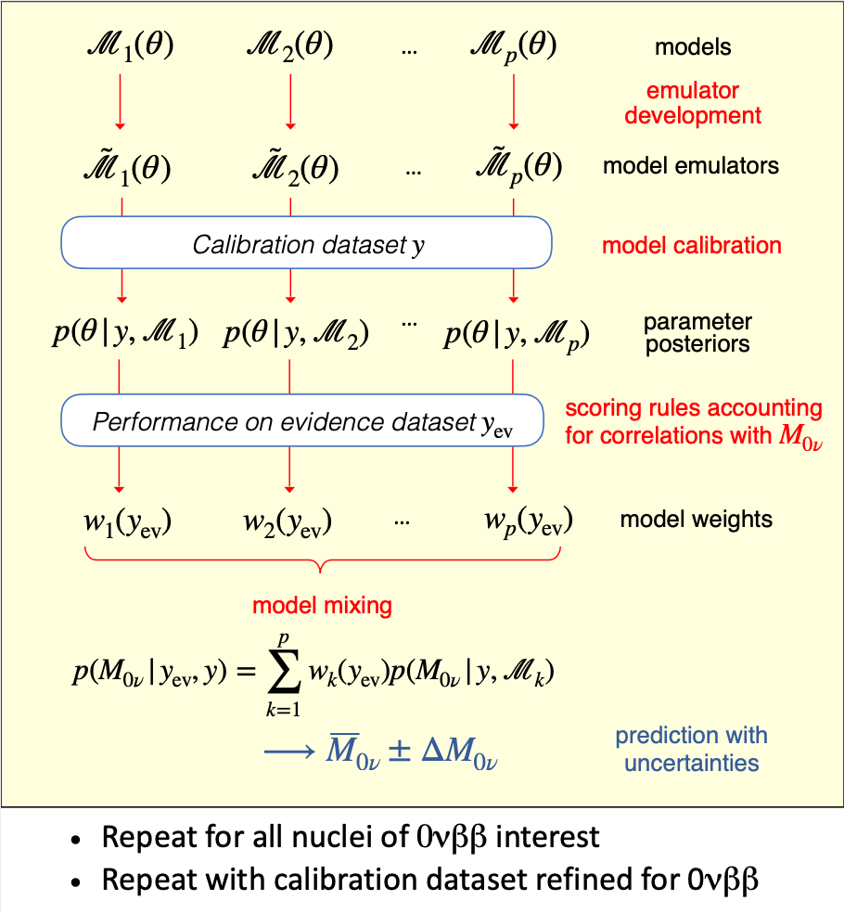
Notes:
My examples are drawn from nuclear structure, reactions, and nuclear astrophysics, but the need for UQ for models is relevant throughout nuclear physics.

Slide 6
Checklist for statistically sound Bayesian inference
✓
Interact with the experts (i.e., statisticians, applied mathematicians)
Incorporate all sources of experimental and theoretical errors
Formulate statistical models for uncertainties
Use as informative priors as is reasonable; test sensitivity to priors
Account for correlations in inputs (type x) and observables (type y)
Propagate uncertainties through the calculation
Use model checking to validate our models
Bayesian updating of knowledge

Slide 7
State of knowledge as probability distributions (pdfs)
pr(A, B | C) “joint probability (density) of A and B given C” (contingent on C)
A, B, C can be observables, parameters, uncertainties, propositions, models, …
cf. quantum mechanics |ψ(x₁, x₂)|² or |ψ(x₁)|² = ∫|ψ(x₁, x₂)|² dx₂ (marginalization)
Bayesian confidence (credible) interval:
68%
95%

Slide 8
State of knowledge as probability distributions (pdfs)
pr(A, B | C) “joint probability (density) of A and B given C” (contingent on C)
A, B, C can be observables, parameters, uncertainties, propositions, models, …
cf. quantum mechanics |ψ(x₁, x₂)|² or |ψ(x₁)|² = ∫|ψ(x₁, x₂)|² dx₂ (marginalization)
Bayesian confidence (credible) interval:
pr(θ | y_{exp} , Σ_{exp} , Σ_{th} , I) ⇒
pdf of model parameters θ given data y_{exp} and experiment/theory errors Σ, plus other information I
Examples of pdfs for model UQ:
68%
95%

Slide 9
State of knowledge as probability distributions (pdfs)
pr(A, B | C) “joint probability (density) of A and B given C” (contingent on C)
A, B, C can be observables, parameters, uncertainties, propositions, models, …
cf. quantum mechanics |ψ(x₁, x₂)|² or |ψ(x₁)|² = ∫|ψ(x₁, x₂)|² dx₂ (marginalization)
Bayesian confidence (credible) interval:
pr(δy_{th} |y_{th} , I) ⇒
pdf of model discrepancy δy_{th} (model error) given order-by-order theory calculations y_{th} plus other information I
Examples of pdfs for model UQ:
68%
95%

Slide 10
State of knowledge as probability distributions (pdfs)
pr(A, B | C) “joint probability (density) of A and B given C” (contingent on C)
A, B, C can be observables, parameters, uncertainties, propositions, models, …
cf. quantum mechanics |ψ(x₁, x₂)|² or |ψ(x₁)|² = ∫|ψ(x₁, x₂)|² dx₂ (marginalization)
Bayesian confidence (credible) interval:
pr(Λ_{b} | y_{th}, I) ⇒
pdf of breakdown scale of EFT expansion given order-by-order theory calculations y_{th} plus other information I
Examples of pdfs for model UQ:
68%
95%

Slide 11
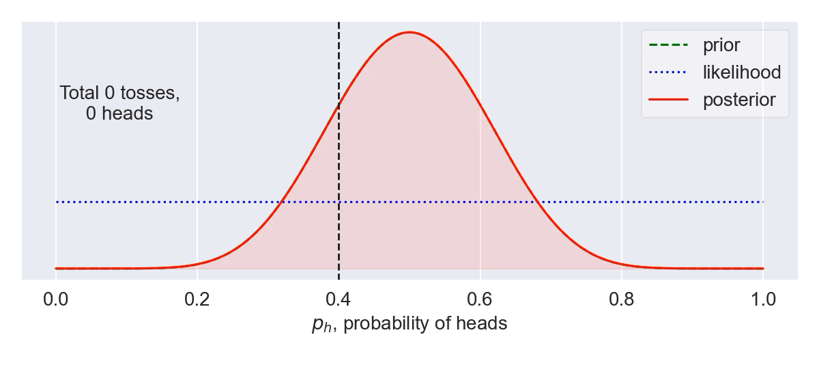
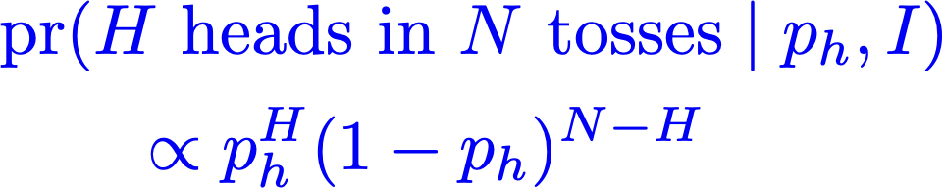
Bayes’ Theorem: How to update knowledge in PDFs
Bayesian updating of knowledge
Example: tossing a biased coin. True probability of heads is p_{h}=0.4, but we don’t know that. So p_{h} is a distribution updated with each toss of the coin.
Likelihood is
Priors are important when few data; can suppress too-wide likelihoods to inhibit overfitting (cf. regularization for ANNs).
Notes:
\usepackage{bm}
\DeclareMathOperator{\pr}{\text{pr}} % Good, but want to handle sizing and | spacing?
{\color{red}\pr(A|B,I)} = \frac{{\color{blue}\pr(B|A,I)} {\color[rgb]{0.000000,0.493151,0.000000}\pr(A|I)}}{\pr(B|A)}
\Longrightarrow
{\color{red}\underbrace{\pr(\bm{\theta} | \mathbf{y}_{\rm exp}, I)}_{\mbox{\scriptsize posterior}}}
\propto
{\color{blue}\underbrace{\pr(\mathbf{y}_{\rm exp} | \bm{\theta}, I)}_{\mbox{\scriptsize likelihood}}}
\times
{\color[rgb]{0.000000,0.493151,0.000000}\underbrace{\pr(\bm{\theta} | I)}_{\mbox{\scriptsize prior}}}
{\color{red}\pr(A|B,I)} = \frac{{\color{blue}\pr(B|A,I)} {\color[rgb]{0.000000,0.493151,0.000000}\pr(A|I)}}{\pr(B|A)}
\Longrightarrow
{\color{red}\underbrace{\pr(x | \mbox{data}, I)}_{\mbox{posterior}}}
\propto
{\color{blue}\underbrace{\pr(\mbox{data} | x, I)}_{\mbox{likelihood}}}
\times
{\color[rgb]{0.000000,0.493151,0.000000}\underbrace{\pr(\mbox{data} | I)}_{\mbox{prior}}}
{\color{red}\pr(\bm{\theta} | \mathrm{y}_{\rm exp}, \Sigma_{\rm exp}, \Sigma_{\rm th}, I)}
\propto {\color{blue}e^{-\frac12 \mathbf{r}^{\intercal}(\Sigma_{\rm exp}+\Sigma_{\rm th})^{-1}\mathbf{r}}}
\times {\color[rgb]{0.000000,0.493151,0.000000} e^{-\bm{\theta}^2/2\bar\theta} }
\usepackage{bm}
\newcommand{\pr}{\text{pr}}
&{\color{blue}
%\mbox{likelihood: }
\pr(\mathbf{y}_{\rm exp} | \bm{\theta}, I) \propto e^{-\chi^2/2}
}
\quad\underset{\rm uncorrelated}{\Longrightarrow}\quad
{\color{blue}
\chi^2 = \sum_i^{\rm data} \mathbf{r}_i\frac{1}{\sigma_i^2}\mathbf{r}_i \;,
\quad
\mathbf{r} \equiv \mathbf{y}_{\rm exp} - \mathbf{y}_{\rm th}(\bm{\theta})
} \\[10pt]
&\quad\mbox{correlated: }
{\color{red}\pr(\bm{\theta} | \mathrm{y}_{\rm exp}, \Sigma_{\rm exp}, \Sigma_{\rm th}, I)}
\propto {\color{blue}e^{-\frac12 \mathbf{r}^{\intercal}(\Sigma_{\rm exp}+\Sigma_{\rm th})^{-1}\mathbf{r}}} \times {\color[rgb]{0.000000,0.493151,0.000000} e^{-\bm{\theta}^2/2\bar\theta^2} }
&{\color{blue}
%\mbox{likelihood: }
\pr(\mathbf{y}_{\rm exp} | \bm{\theta}, I) \propto e^{-\chi^2/2}
}
\quad\underset{\rm uncorrelated}{\Longrightarrow}\quad
{\color{blue}
\chi^2 = \sum_i^{\rm data} \mathbf{r}_i\frac{1}{\sigma_i^2}\mathbf{r}_i \;,
\quad
\mathbf{r} \equiv \mathbf{y}_{\rm exp} - \mathbf{y}_{\rm th}(\bm{\theta})
} \\[10pt]
&\quad\mbox{correlated: }
{\color{red}\pr(\bm{\theta} | \mathrm{y}_{\rm exp}, \Sigma_{\rm exp}, \Sigma_{\rm th}, I)}
\propto {\color{blue}e^{-\frac12 \mathbf{r}^{\intercal}(\Sigma_{\rm exp}+\Sigma_{\rm th})^{-1}\mathbf{r}}} \times {\color[rgb]{0.000000,0.493151,0.000000} e^{-\bm{\theta}^2/2\bar\theta^2} }

Slide 12
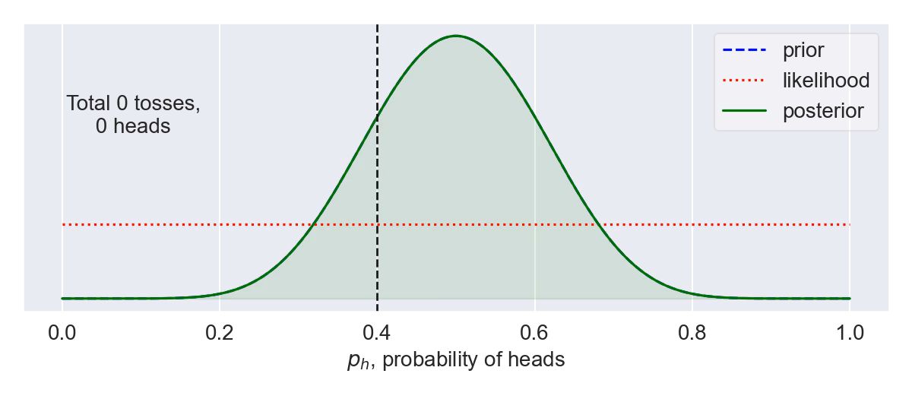
Bayes’ Theorem: How to update knowledge in PDFs
Bayesian updating of knowledge
Example: tossing a biased coin. True probability of heads is p_{h}=0.4, but we don’t know that. So p_{h} is a distribution updated with each toss of the coin.
Likelihood is
Priors are important when few data; can suppress too-wide likelihoods to inhibit overfitting (cf. regularization for ANNs).
Notes:
\usepackage{bm}
\DeclareMathOperator{\pr}{\text{pr}} % Good, but want to handle sizing and | spacing?
{\color{red}\pr(A|B,I)} = \frac{{\color{blue}\pr(B|A,I)} {\color[rgb]{0.000000,0.493151,0.000000}\pr(A|I)}}{\pr(B|A)}
\Longrightarrow
{\color{red}\underbrace{\pr(\bm{\theta} | \mathbf{y}_{\rm exp}, I)}_{\mbox{\scriptsize posterior}}}
\propto
{\color{blue}\underbrace{\pr(\mathbf{y}_{\rm exp} | \bm{\theta}, I)}_{\mbox{\scriptsize likelihood}}}
\times
{\color[rgb]{0.000000,0.493151,0.000000}\underbrace{\pr(\bm{\theta} | I)}_{\mbox{\scriptsize prior}}}
{\color{red}\pr(A|B,I)} = \frac{{\color{blue}\pr(B|A,I)} {\color[rgb]{0.000000,0.493151,0.000000}\pr(A|I)}}{\pr(B|A)}
\Longrightarrow
{\color{red}\underbrace{\pr(x | \mbox{data}, I)}_{\mbox{posterior}}}
\propto
{\color{blue}\underbrace{\pr(\mbox{data} | x, I)}_{\mbox{likelihood}}}
\times
{\color[rgb]{0.000000,0.493151,0.000000}\underbrace{\pr(\mbox{data} | I)}_{\mbox{prior}}}
{\color{red}\pr(\bm{\theta} | \mathrm{y}_{\rm exp}, \Sigma_{\rm exp}, \Sigma_{\rm th}, I)}
\propto {\color{blue}e^{-\frac12 \mathbf{r}^{\intercal}(\Sigma_{\rm exp}+\Sigma_{\rm th})^{-1}\mathbf{r}}}
\times {\color[rgb]{0.000000,0.493151,0.000000} e^{-\bm{\theta}^2/2\bar\theta} }
\usepackage{bm}
\newcommand{\pr}{\text{pr}}
&{\color{blue}
%\mbox{likelihood: }
\pr(\mathbf{y}_{\rm exp} | \bm{\theta}, I) \propto e^{-\chi^2/2}
}
\quad\underset{\rm uncorrelated}{\Longrightarrow}\quad
{\color{blue}
\chi^2 = \sum_i^{\rm data} \mathbf{r}_i\frac{1}{\sigma_i^2}\mathbf{r}_i \;,
\quad
\mathbf{r} \equiv \mathbf{y}_{\rm exp} - \mathbf{y}_{\rm th}(\bm{\theta})
} \\[10pt]
&\quad\mbox{correlated: }
{\color{red}\pr(\bm{\theta} | \mathrm{y}_{\rm exp}, \Sigma_{\rm exp}, \Sigma_{\rm th}, I)}
\propto {\color{blue}e^{-\frac12 \mathbf{r}^{\intercal}(\Sigma_{\rm exp}+\Sigma_{\rm th})^{-1}\mathbf{r}}} \times {\color[rgb]{0.000000,0.493151,0.000000} e^{-\bm{\theta}^2/2\bar\theta^2} }
&{\color{blue}
%\mbox{likelihood: }
\pr(\mathbf{y}_{\rm exp} | \bm{\theta}, I) \propto e^{-\chi^2/2}
}
\quad\underset{\rm uncorrelated}{\Longrightarrow}\quad
{\color{blue}
\chi^2 = \sum_i^{\rm data} \mathbf{r}_i\frac{1}{\sigma_i^2}\mathbf{r}_i \;,
\quad
\mathbf{r} \equiv \mathbf{y}_{\rm exp} - \mathbf{y}_{\rm th}(\bm{\theta})
} \\[10pt]
&\quad\mbox{correlated: }
{\color{red}\pr(\bm{\theta} | \mathrm{y}_{\rm exp}, \Sigma_{\rm exp}, \Sigma_{\rm th}, I)}
\propto {\color{blue}e^{-\frac12 \mathbf{r}^{\intercal}(\Sigma_{\rm exp}+\Sigma_{\rm th})^{-1}\mathbf{r}}} \times {\color[rgb]{0.000000,0.493151,0.000000} e^{-\bm{\theta}^2/2\bar\theta^2} }

Slide 13
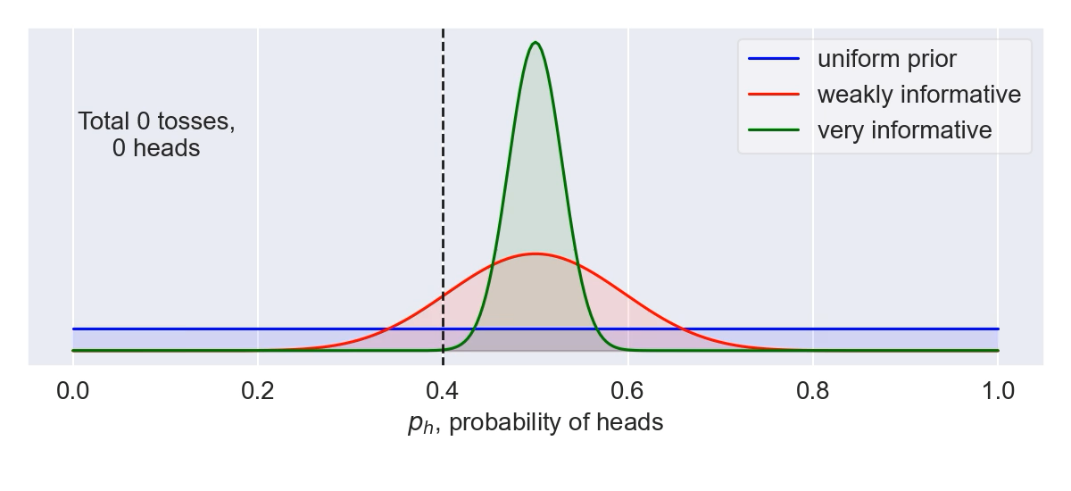
Bayes’ Theorem: How to update knowledge in PDFs
Bayesian updating of knowledge
Use as informative priors as is reasonable; test sensitivity to priors
Example: tossing a biased coin. True probability of heads is p_{h}=0.4, but we don’t know that. So p_{h} is a distribution updated with each toss of the coin.
Likelihood is
Use model checking to validate our models
Notes:
\usepackage{bm}
\DeclareMathOperator{\pr}{\text{pr}} % Good, but want to handle sizing and | spacing?
{\color{red}\pr(A|B,I)} = \frac{{\color{blue}\pr(B|A,I)} {\color[rgb]{0.000000,0.493151,0.000000}\pr(A|I)}}{\pr(B|A)}
\Longrightarrow
{\color{red}\underbrace{\pr(\bm{\theta} | \mathbf{y}_{\rm exp}, I)}_{\mbox{\scriptsize posterior}}}
\propto
{\color{blue}\underbrace{\pr(\mathbf{y}_{\rm exp} | \bm{\theta}, I)}_{\mbox{\scriptsize likelihood}}}
\times
{\color[rgb]{0.000000,0.493151,0.000000}\underbrace{\pr(\bm{\theta} | I)}_{\mbox{\scriptsize prior}}}
{\color{red}\pr(A|B,I)} = \frac{{\color{blue}\pr(B|A,I)} {\color[rgb]{0.000000,0.493151,0.000000}\pr(A|I)}}{\pr(B|A)}
\Longrightarrow
{\color{red}\underbrace{\pr(x | \mbox{data}, I)}_{\mbox{posterior}}}
\propto
{\color{blue}\underbrace{\pr(\mbox{data} | x, I)}_{\mbox{likelihood}}}
\times
{\color[rgb]{0.000000,0.493151,0.000000}\underbrace{\pr(\mbox{data} | I)}_{\mbox{prior}}}
{\color{red}\pr(\bm{\theta} | \mathrm{y}_{\rm exp}, \Sigma_{\rm exp}, \Sigma_{\rm th}, I)}
\propto {\color{blue}e^{-\frac12 \mathbf{r}^{\intercal}(\Sigma_{\rm exp}+\Sigma_{\rm th})^{-1}\mathbf{r}}}
\times {\color[rgb]{0.000000,0.493151,0.000000} e^{-\bm{\theta}^2/2\bar\theta} }
\usepackage{bm}
\newcommand{\pr}{\text{pr}}
&{\color{blue}
%\mbox{likelihood: }
\pr(\mathbf{y}_{\rm exp} | \bm{\theta}, I) \propto e^{-\chi^2/2}
}
\quad\underset{\rm uncorrelated}{\Longrightarrow}\quad
{\color{blue}
\chi^2 = \sum_i^{\rm data} \mathbf{r}_i\frac{1}{\sigma_i^2}\mathbf{r}_i \;,
\quad
\mathbf{r} \equiv \mathbf{y}_{\rm exp} - \mathbf{y}_{\rm th}(\bm{\theta})
} \\[10pt]
&\quad\mbox{correlated: }
{\color{red}\pr(\bm{\theta} | \mathrm{y}_{\rm exp}, \Sigma_{\rm exp}, \Sigma_{\rm th}, I)}
\propto {\color{blue}e^{-\frac12 \mathbf{r}^{\intercal}(\Sigma_{\rm exp}+\Sigma_{\rm th})^{-1}\mathbf{r}}} \times {\color[rgb]{0.000000,0.493151,0.000000} e^{-\bm{\theta}^2/2\bar\theta^2} }
&{\color{blue}
%\mbox{likelihood: }
\pr(\mathbf{y}_{\rm exp} | \bm{\theta}, I) \propto e^{-\chi^2/2}
}
\quad\underset{\rm uncorrelated}{\Longrightarrow}\quad
{\color{blue}
\chi^2 = \sum_i^{\rm data} \mathbf{r}_i\frac{1}{\sigma_i^2}\mathbf{r}_i \;,
\quad
\mathbf{r} \equiv \mathbf{y}_{\rm exp} - \mathbf{y}_{\rm th}(\bm{\theta})
} \\[10pt]
&\quad\mbox{correlated: }
{\color{red}\pr(\bm{\theta} | \mathrm{y}_{\rm exp}, \Sigma_{\rm exp}, \Sigma_{\rm th}, I)}
\propto {\color{blue}e^{-\frac12 \mathbf{r}^{\intercal}(\Sigma_{\rm exp}+\Sigma_{\rm th})^{-1}\mathbf{r}}} \times {\color[rgb]{0.000000,0.493151,0.000000} e^{-\bm{\theta}^2/2\bar\theta^2} }

Slide 14
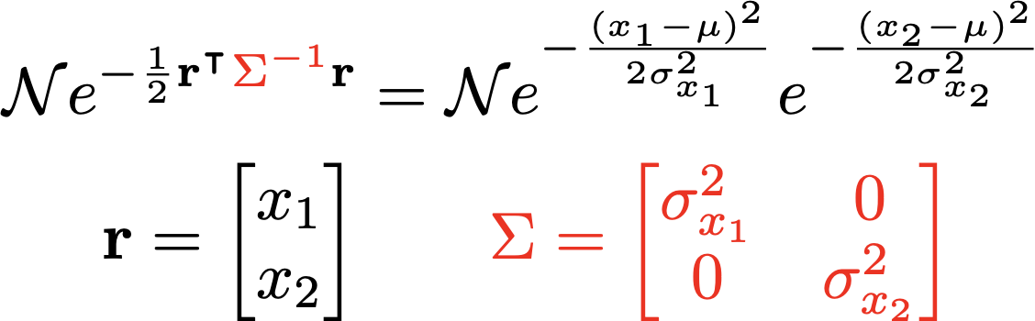
Account for correlations in inputs and observables
pr(x₁, x₂| y) “joint probability (density) of x₁ and x₂ given y” (contingent on y)
marginalized
pr(x₁|y)
pr(x₂|y)
joint
x₂
pr(x₁ ,x₂|y)
x₁
x₂
Notes:
\mathcal{N}e^{-\frac12 \mathbf{r}^{\intercal}{\color{red}\Sigma^{-1}}\mathbf{r}}
&= \mathcal{N} e^{-\frac{(x-\mu)^2}{2\sigma_x^2}} e^{-\frac{(y-\mu)^2}{2\sigma_y^2}}
\\
\mathbf{r} = \begin{bmatrix} x \\ y \end{bmatrix} &
\qquad
{\color{red}\Sigma = \begin{bmatrix} \sigma_x^2 & 0 \\
0 & \sigma_y^2
\end{bmatrix}}
\mathcal{N}e^{-\frac12 \mathbf{r}^{\intercal}{\color{red}\Sigma^{-1}}\mathbf{r}}
&= \mbox{correlated gaussian}
% = \mathcal{N} e^{-\frac{(x-\mu)^2}{2\sigma^2}} e^{-\frac{(y-\mu)^2}{2\sigma^2}}
\\
\mathbf{r} = \begin{bmatrix} x \\ y \end{bmatrix}
\qquad &
{\color{red}\Sigma = \begin{bmatrix} \sigma_x^2 & \rho\sigma_x\sigma_y \\
\rho\sigma_x\sigma_y & \sigma_y^2
\end{bmatrix}}

Slide 15
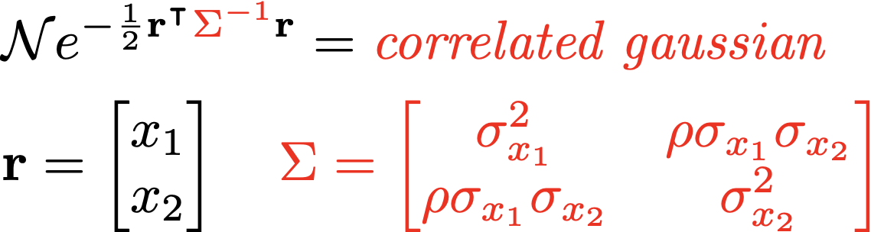
Account for correlations in inputs and observables
pr(x₁, x₂| y) “joint probability (density) of x₁ and x₂ given y” (contingent on y)
marginalized
pr(x₁|y)
pr(x₂|y)
joint
y
x₂
pr(x₁ ,x₂|y)
x₁
X
y
x₂
Notes:
\mathcal{N}e^{-\frac12 \mathbf{r}^{\intercal}{\color{red}\Sigma^{-1}}\mathbf{r}}
&= \mathcal{N} e^{-\frac{(x-\mu)^2}{2\sigma_x^2}} e^{-\frac{(y-\mu)^2}{2\sigma_y^2}}
\\
\mathbf{r} = \begin{bmatrix} x \\ y \end{bmatrix} &
\qquad
{\color{red}\Sigma = \begin{bmatrix} \sigma_x^2 & 0 \\
0 & \sigma_y^2
\end{bmatrix}}
\mathcal{N}e^{-\frac12 \mathbf{r}^{\intercal}{\color{red}\Sigma^{-1}}\mathbf{r}}
&= \mbox{correlated gaussian}
% = \mathcal{N} e^{-\frac{(x-\mu)^2}{2\sigma^2}} e^{-\frac{(y-\mu)^2}{2\sigma^2}}
\\
\mathbf{r} = \begin{bmatrix} x \\ y \end{bmatrix}
\qquad &
{\color{red}\Sigma = \begin{bmatrix} \sigma_x^2 & \rho\sigma_x\sigma_y \\
\rho\sigma_x\sigma_y & \sigma_y^2
\end{bmatrix}}

Slide 16
Formulate statistical models for uncertainties
Interact with the experts: statisticians say any model better than none!
George Box: “All models are wrong, but some are useful”
In what ways can a theoretical model be wrong?
Uncertainty from numerical method (e.g., differential equation error)
Truncation of Hilbert space (e.g., lattice volume/spacing or ho model space)
Model discrepancy
Incomplete or in parts incorrect physical model
Effective field theory expansion truncation error
Incorporate all sources of expt. and theoretical errors
Mostly systematic and correlated (doesn’t mean they can’t be treated as random!).
Systematic: error is not reduced when more observations are averaged
Correlated: e.g., model error in binding energy for oxygen chain all in same direction
Bayesian statistics is ideal for modeling, combining, and propagating theory errors!
Notes:
For 1., can use machine learning. Neural network, for example, or just a GP.
Informed is better than uninformed, but anything better than nothing.
Model discrepancy (“All models are wrong, but some are useful” – George Box)
Incomplete or in parts incorrect physical model
Effective field theory expansion truncation error

Slide 17
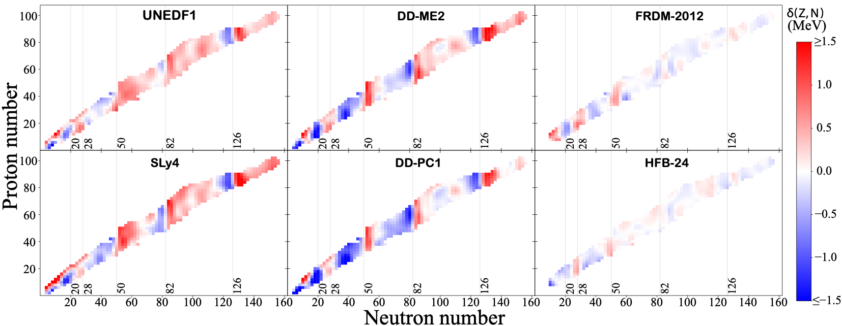
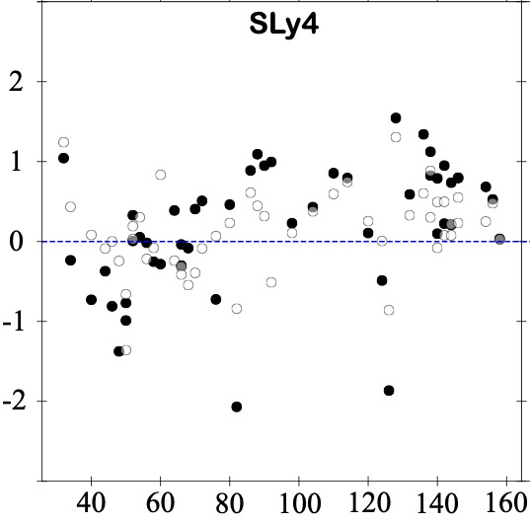
Formulate statistical models for uncertainties
Interact with the experts: statisticians say any model better than none!
George Box: “All models are wrong, but some are useful”
1. Model distribution of residuals:
Train the residuals on Gaussian Process model or with Bayesian Neural Network on one set; test on another set
S_{2n} residuals (MeV)
original
with GP model
Figures adapted from Mass extrapolations with BNN and GP, L. Neufcourt et al. Phys. Rev. C 98, 034318 (2018)
Neutron number
Notes:
For 1., can use machine learning. Neural network, for example, or just a GP.
Informed is better than uninformed, but anything better than nothing.
Model discrepancy (“All models are wrong, but some are useful” – George Box)
Incomplete or in parts incorrect physical model
Effective field theory expansion truncation error
Figures 5 and Fig. 6 show the residuals of six repre- sentative nuclear mass models as a function of the neu- tron number before and after statistical corrections with GP(T+H) and BNN(T+H) respectively. In both GP and BNN, one observes that nearly every white circle, cor- responding to a prediction error of our emulator for a given nucleus, is closer to the data than its corresponding black dot, representing a global mass model prediction error without GP or BNN. This indicates that both GP and BNN corrections improve the predictions systemat- ically. Additionally, several local trends of the residuals are visibly attenuated, and the distributions of the cor- rected residuals are closer to having zero means and to being independent Gaussian. We observe that the im- provement in performance for our statistical correction is strongest for the relativistic DFT models (DD-ME2 and DD-PC1), and weakest for the more phenomenological models FRDM-2012 and HFB-24. This is not surprising, as we expect the residuals of more microscopic models to exhibit appreciable structure, whereas there is little hope to improve much the phenomenological models which are fitted closely to the data.

Slide 18
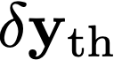
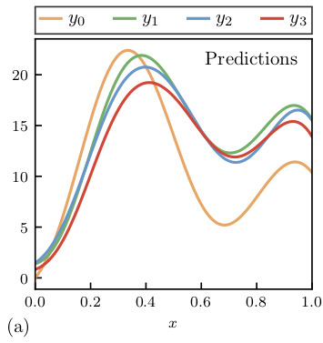
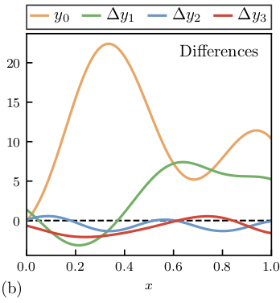
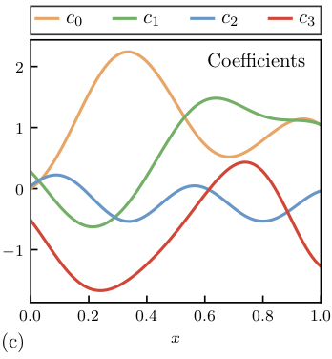
Formulate statistical models for uncertainties
Interact with the experts: statisticians say any model better than none!
Revised George Box: “All models are wrong, but some models that know when they are wrong, are useful.”
2. For EFTs, learn from convergence pattern of observables
Use model checking to validate our models
[dimensionless]
}
Estimate variance → c
Theory at order k:
Omitted orders:
Notes:
For 1., can use machine learning. Neural network, for example, or just a GP.
Informed is better than uninformed, but anything better than nothing.
Model discrepancy (“All models are wrong, but some are useful” – George Box)
Incomplete or in parts incorrect physical model
Effective field theory expansion truncation error

Slide 19
Outline
Thinking about uncertainty quantification (UQ) for models
BAND: emulators, calibration, model mixing, expt. design
Summary and outlook

Slide 20
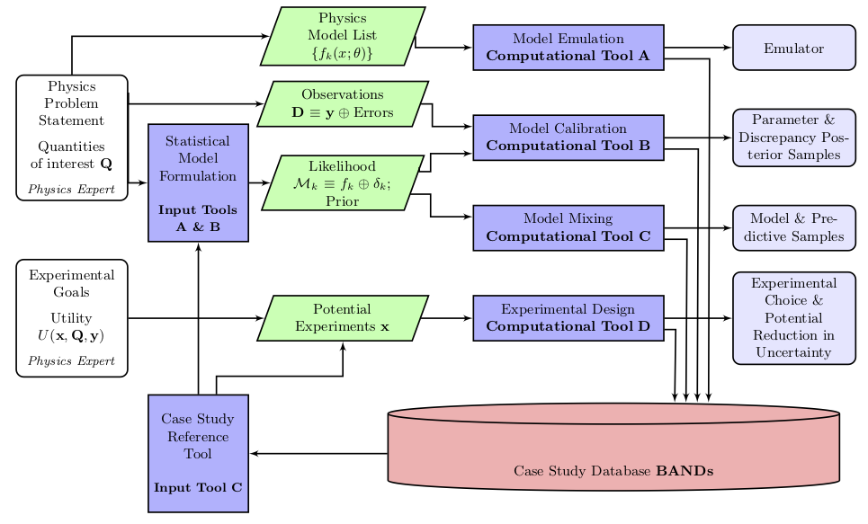
BAND (Bayesian Analysis of Nuclear Dynamics)
Goal: Facilitate principled Uncertainty Quantification in Nuclear Physics
An NSF CSSI Framework (started 7/2020)
Look to https://bandframework.github.io/ for papers, talks, and software!
Notes:
Cyberinfrastructure for Sustained Scientific Innovation

Slide 21
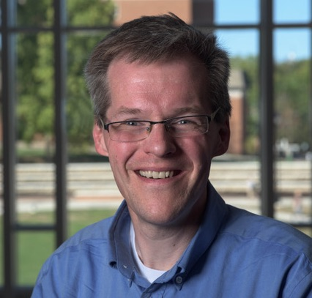
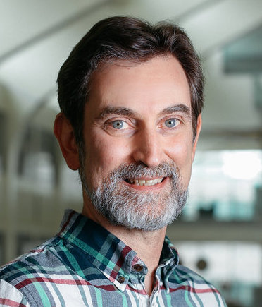
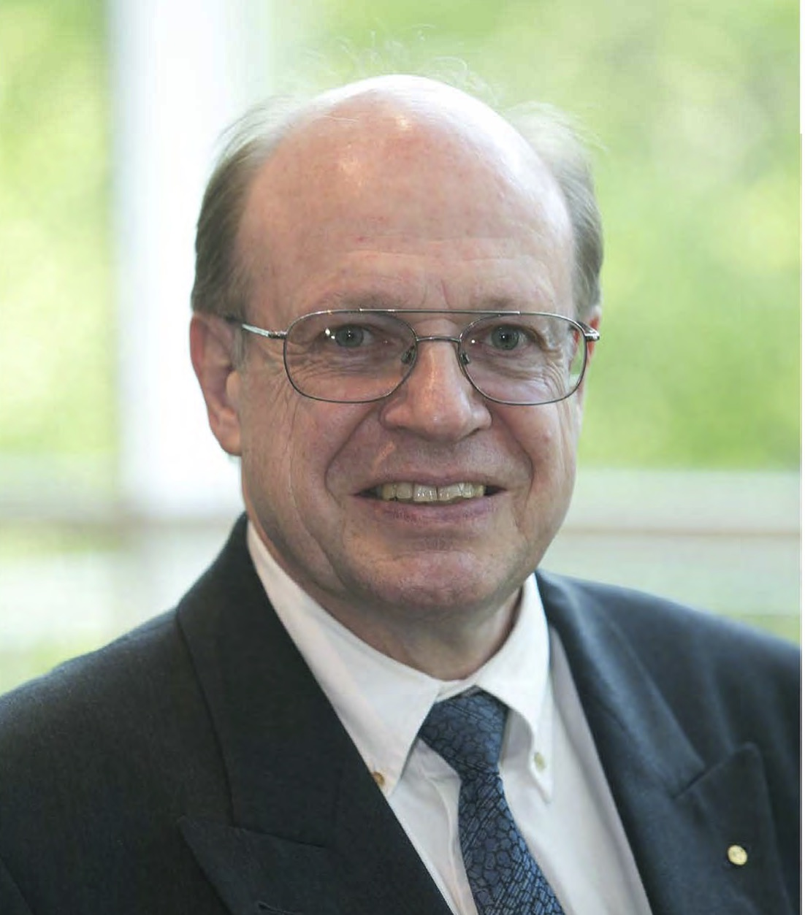
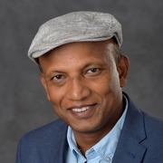
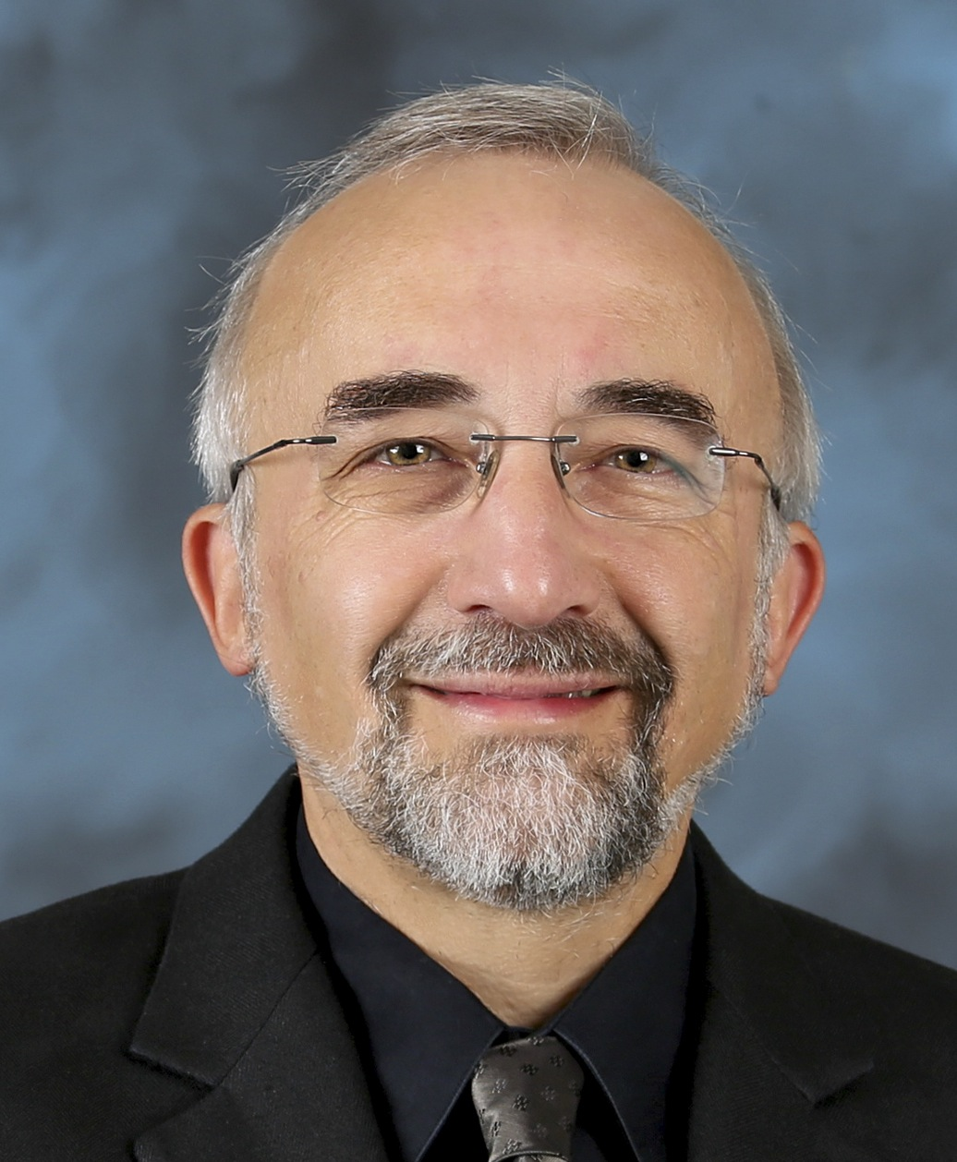
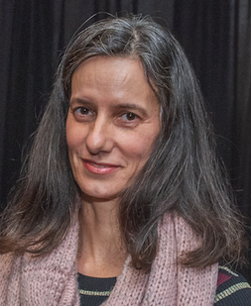
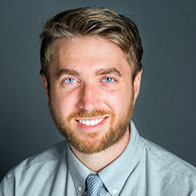
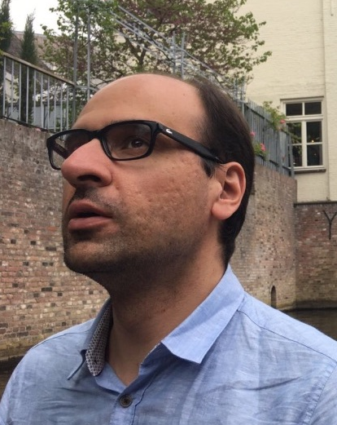
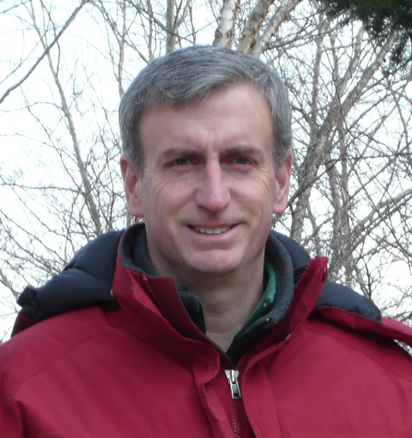
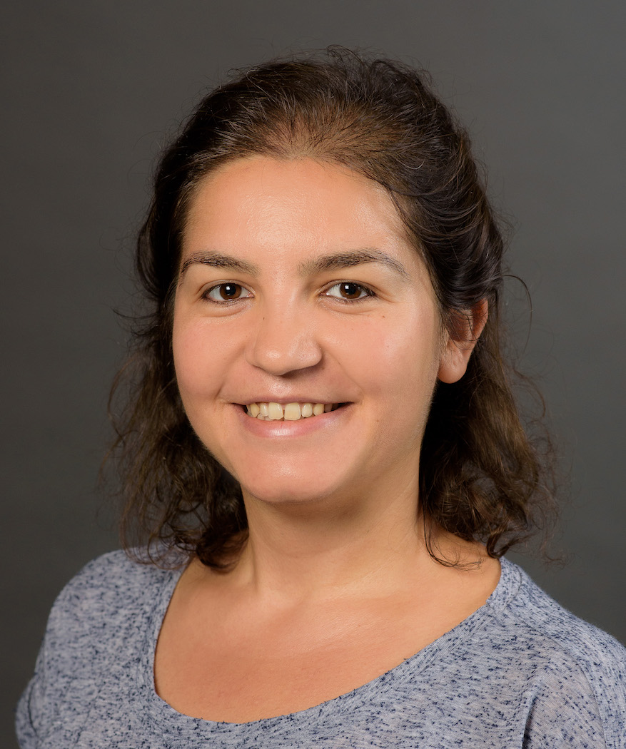
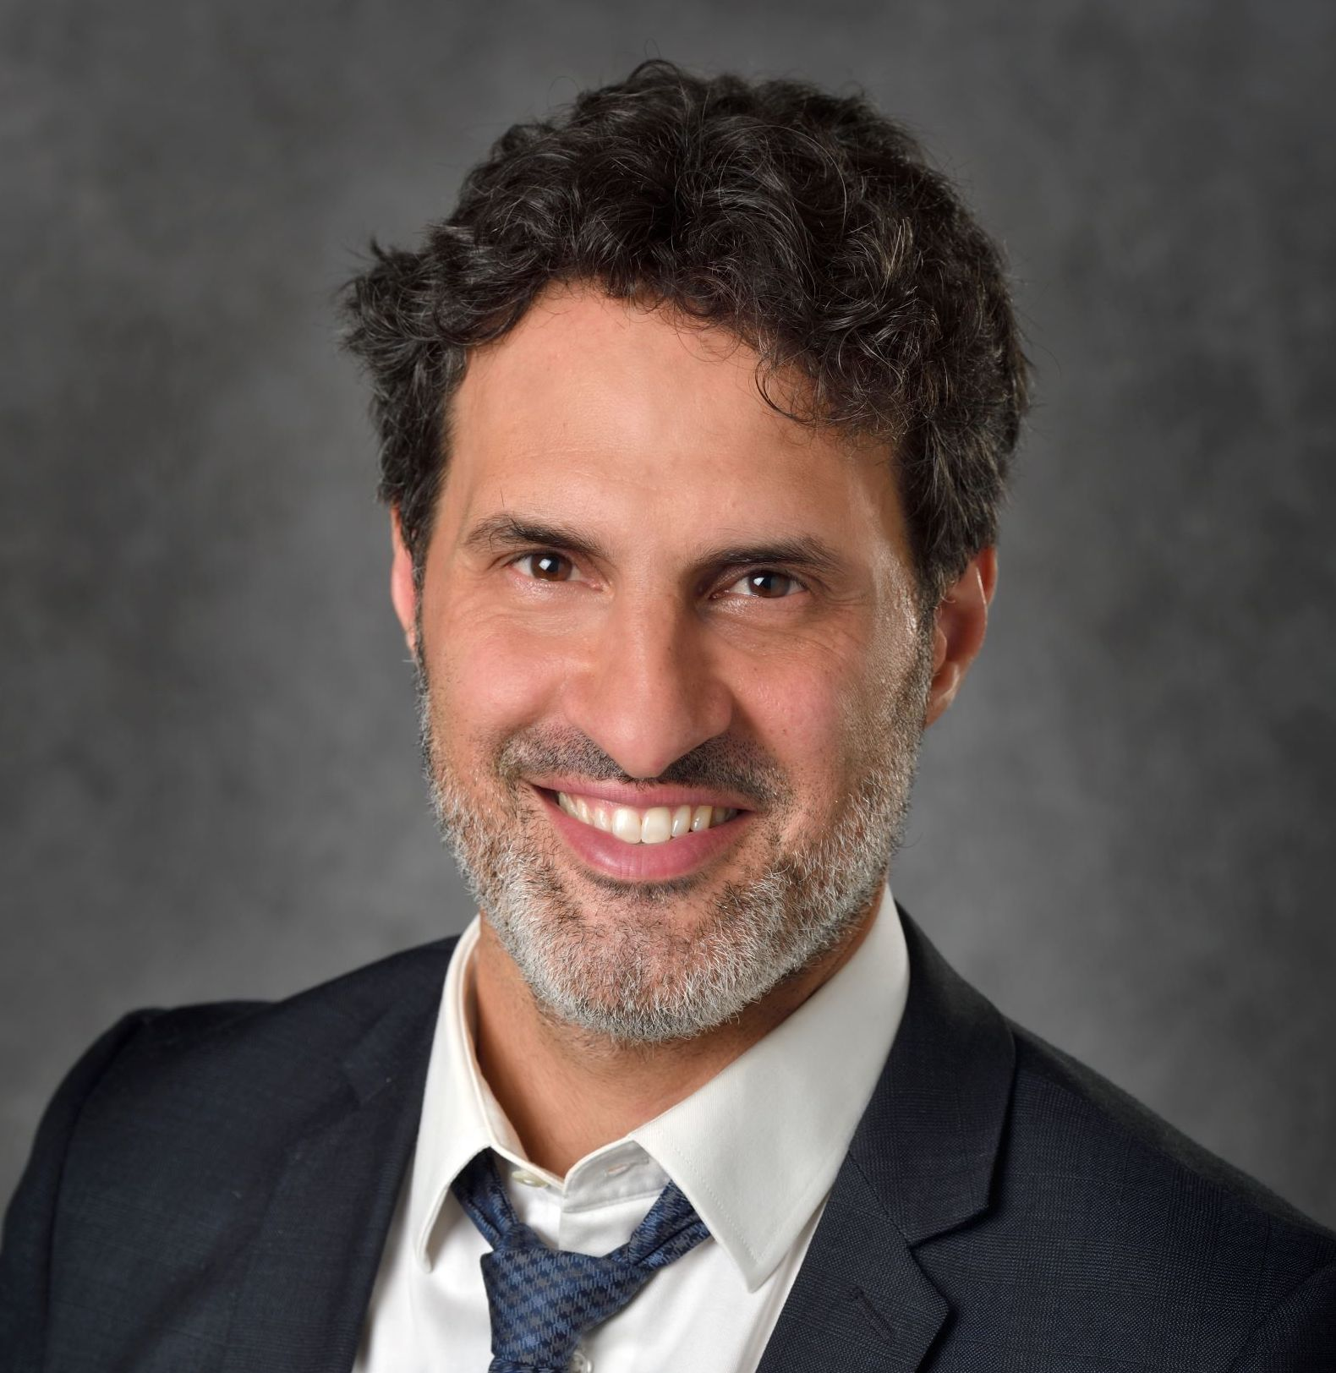
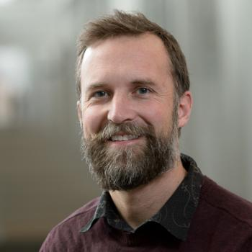

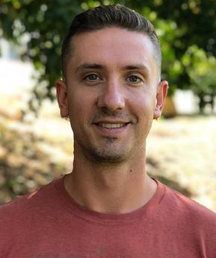

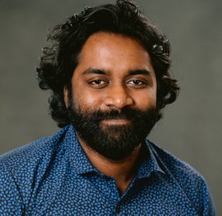
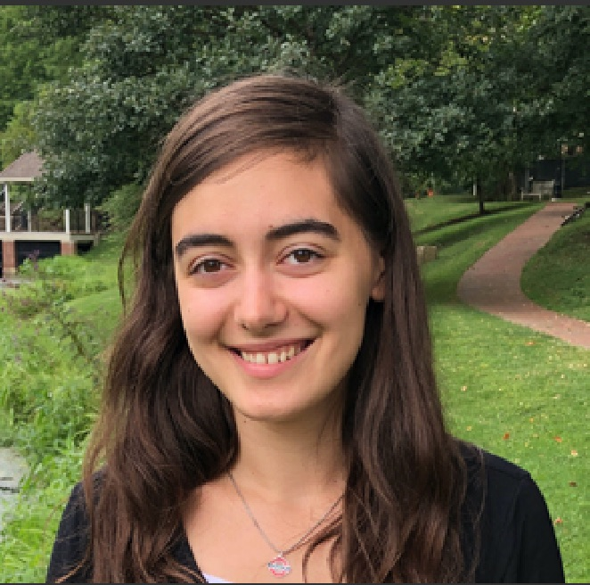
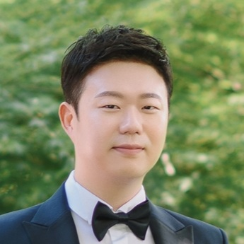
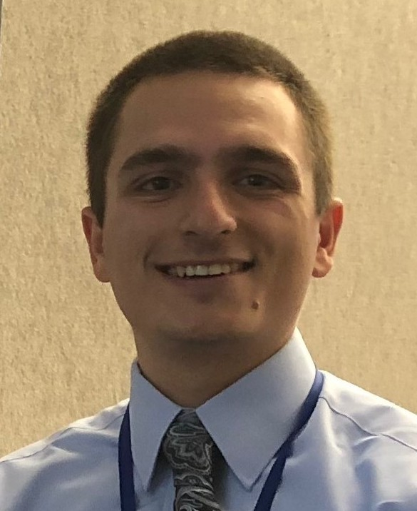
BAND (Bayesian Analysis of Nuclear Dynamics)
Goal: Facilitate principled Uncertainty Quantification in Nuclear Physics
D. Phillips
R. Furnstahl
U. Heinz
T. Maiti
W. Nazarewicz
F. Nunes
An NSF CSSI Framework (started 7/2020)
Look to https://bandframework.github.io/ for manifeso and developments!
M. Plumlee
M. Pratola
S. Pratt
Ö. Sürer
F. Viens
S. Wild
P. Giuliani
D. Odell
M. Chan
D. Liyanage
A. Semposki
M. Son
J. Yannotty
Notes:
Cyberinfrastructure for Sustained Scientific Innovation

Slide 22
BAND (Bayesian Analysis of Nuclear Dynamics)
High-fidelity models may be too expensive → use an emulator instead!
An NSF CSSI Framework (started 7/2020)
Look to https://bandframework.github.io/ for papers, talks, and software!
Notes:
Cyberinfrastructure for Sustained Scientific Innovation

Slide 23
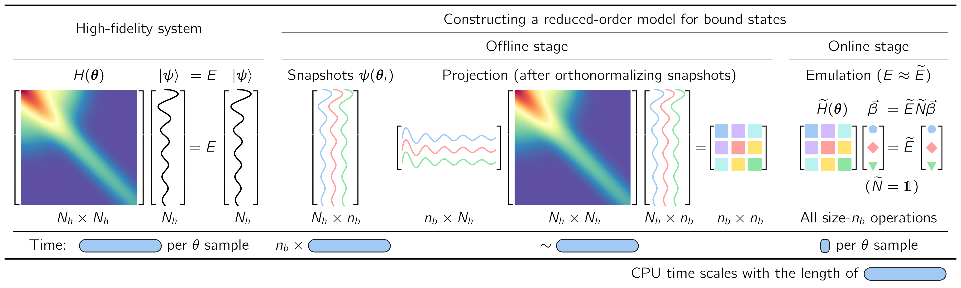
Constructing a reduced-basis model (aka emulator)
J. A. Melendez et al., J. Phys. G 49, 102001 (2022)
E. Bonilla, P. Giuliani et al., Phys. Rev. C 106, 054322
P. Giuliani, K. Godbey et al., arXiv:2209.13039.
C. Drischler et al., Quarto + arXiv:2212.04912
Offline stage (pre-calculate):
Construct basis using snapshots from high-fidelity system (simulator)
Project high-fidelity system to small-space using snapshots
Online stage (emulator):
Make many predictions fast & accurately (e.g., for Bayesian analysis)
Notes:
Parameter sets using a greedy algorithm, Latin-hypercube sampling, etc.
Contains all the relevant information needed for the calculation, while being much cheaper to evaluate.
Workflow of how to construct a snapshot-based reduced-order model.
From that high-fidelity system we extract snapshots.
With snapshots, we project the high-fidelity solution.
All offline.
Predictions in online stage.
Faster than their high-fidelity counterpart.

Slide 24
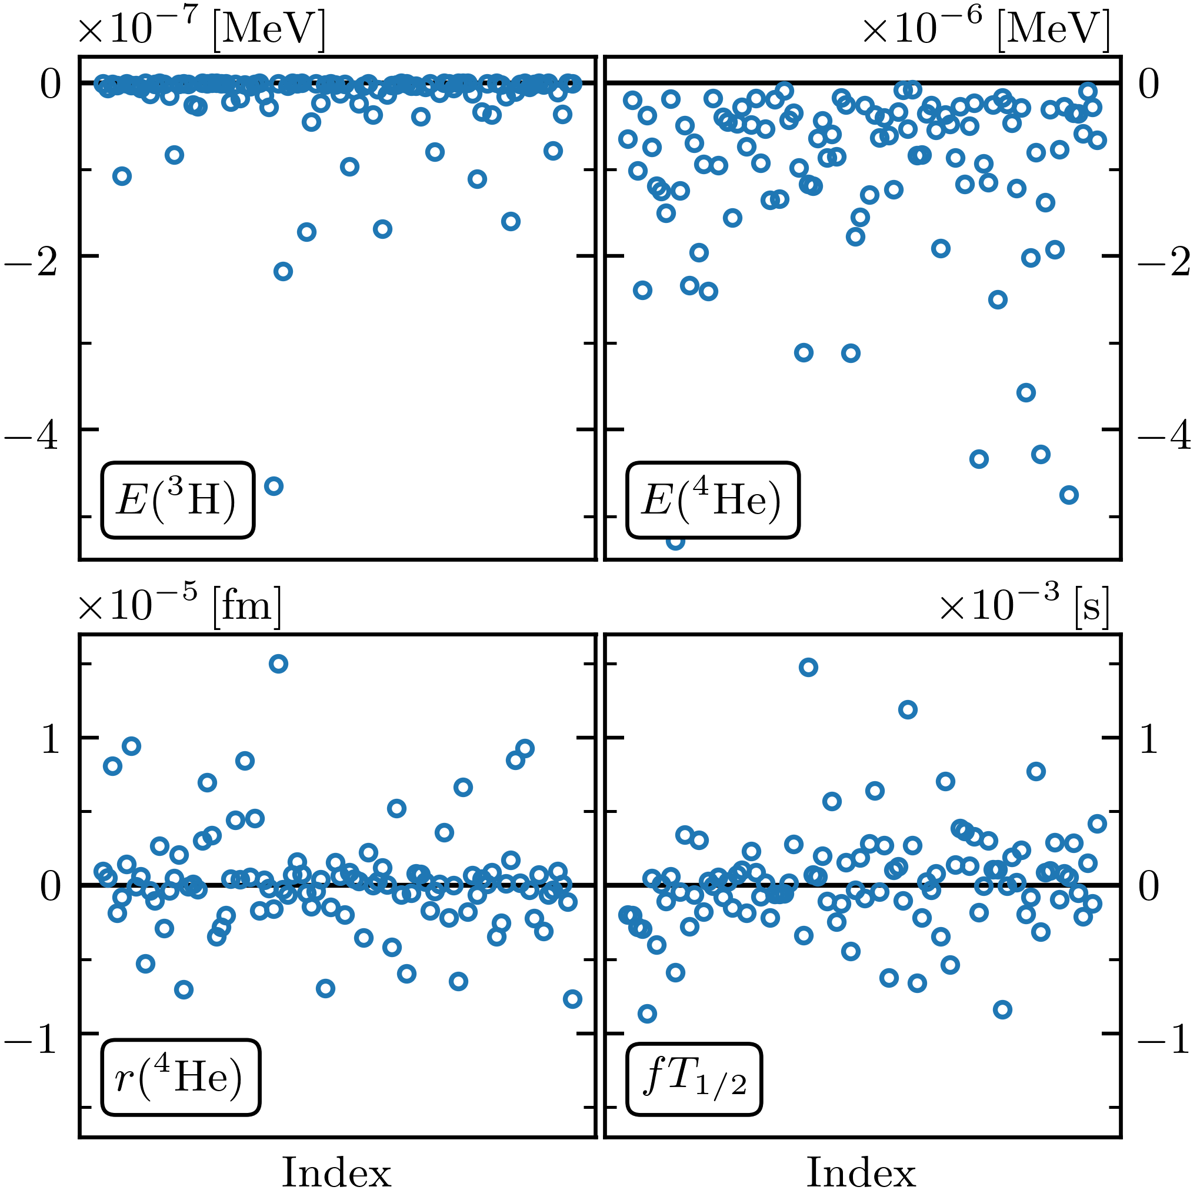
Eigenvector continuation emulators for nuclear observables
Basic idea: a small # of ground-state eigenvectors from a selection of parameter sets is an extremely effective variational basis for other parameter sets. Characteristics: fast and accurate!
Emulator residuals
Wesolowski et al., PRC 104, 064001 (2021)
⁴He energy
EC introduced by Frame et al.
König et al., PLB 810, 135814 (2020)
Emulator doesn’t require specialized calculations!

Slide 25
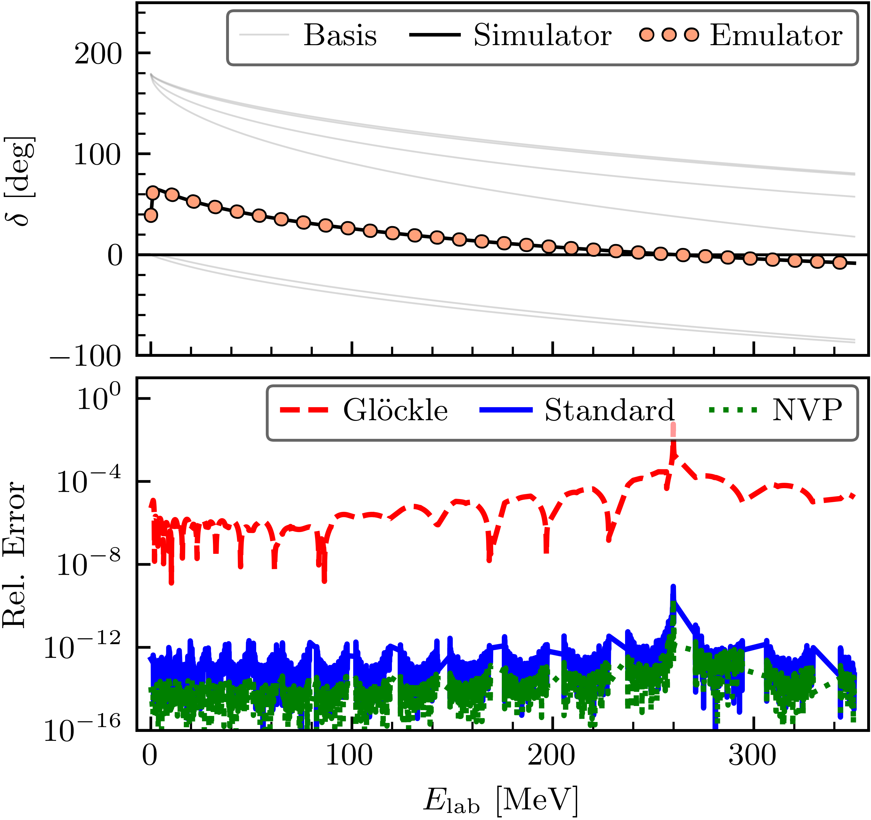
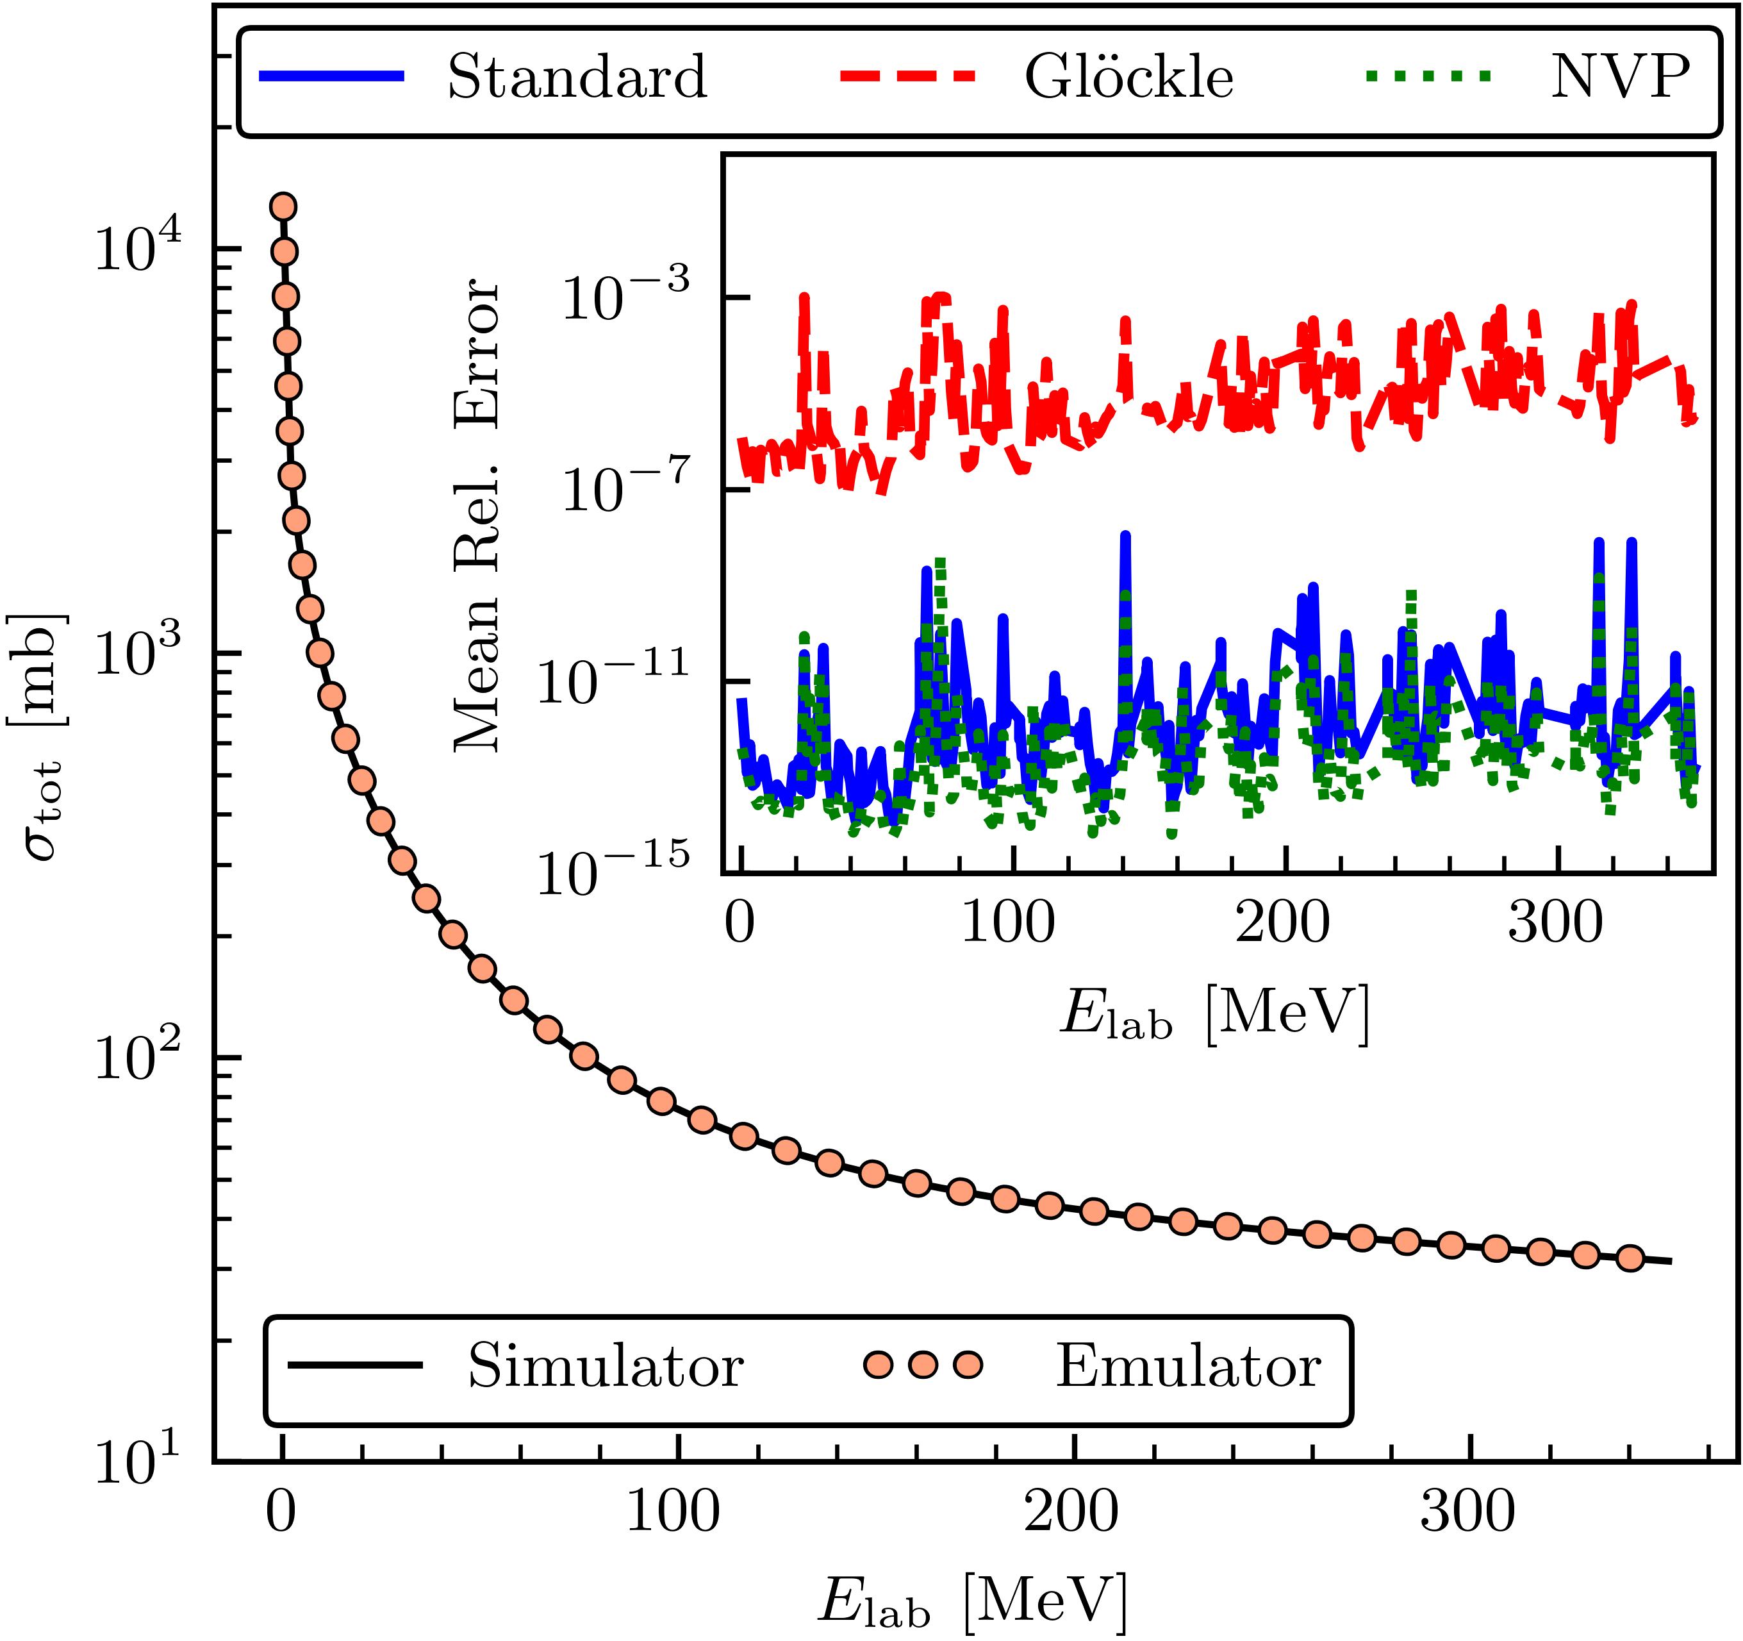
J. Melendez
C. Drischler
RBM emulators for NN and 3N scattering
NN scattering by rjf et al., PLB (2020) using the Kohn variational principle.
Improved by Drischler et al., PLB (2021) (e.g., mitigate Kohn anomalies).
Two-body emulation w/o wfs by Melendez et al., PLB (2021).
NN phase shifts for χEFT potential (SMS)
A. Garcia
X. Zhang
3-body scattering? E.g, for Bayesian χEFT LEC estimation.
→ X. Zhang, rjf proof of principle (2022).
A. Garcia et al., arXiv:2301.05093
Notes:
Developments at top were proof of principle until NVP

Slide 26
RBM emulators for EDFs
Energy density functionals (EDFs) present new challenges.
P. Giuliani et al., “Bayes goes fast …” (also “Training and Projecting”) → apply Galerkin RBM to EDFs (covariant mean field, Skyrme)
Efficient basis to evaluate functional for many parameter sets.
→ Fast and accurate emulation, ideal for Bayesian inference!
Pablo Giuliani
D. Odell
Coming soon: RBM for non-linear, non-affine problems. BAND: ROSE software (e.g., for opt. potl.)
Notes:
Developments at top were proof of principle until NVP

Slide 27
BAND (Bayesian Analysis of Nuclear Dynamics)
Calibrating a model means to update distributions of its parameters based on data.
An NSF CSSI Framework (started 7/2020)
Look to https://bandframework.github.io/ for papers, talks, and software!
Notes:
Cyberinfrastructure for Sustained Scientific Innovation

Slide 28
Fast & rigorous constraints on chiral three-nucleon forces from few-body observables [original title]
Wesolowski, Svensson, Ekström, Forssén, rjf, Melendez, and Phillips, PRC 104, 064001 (2021)
BUQEYE Collaboration
See also: Djärv et al., PRC (2022) on A=6 nuclei; Svensson et al., PRC (2023) on Bayesian LEC estimation; Alnamlah et al., Front. Phys. (2022) on EFT for rotational bands; Acharya et al. Front. Phys. (2022) on E&M observables; Poudel et al., J. Phys. G (2022) on 3He-α scattering; Baker et al., PRC (2022) on N-A, …
Notebook with all figures at
https://buqeye.github.io
expansion
Q⁰
Chiral 3N forces: estimate constraints on c_{D} and c_{E}
Few-body observables (cf. other possibilities): ³H ground-state energy; ³H β-decay half-life; ⁴He ground-state energy; ⁴He charge radius
Q²
c_{E}
c_{D}
Q³
Rigorous: statistical best practices for parameter estimation
Fast: uses eigenvector continuation emulators for observables
Q ~ 1/3
Notes:
Sarah Wesolowski, Isak Svensson

Slide 29
Full Bayesian approach to calibration parameters
Experimental data
Other info (EFT scheme/scale, etc.)
NN and 3N LECs
Truncation error variance
EFT expansion parameter
Individual pdfs; everything has priors!
All experiment and theory errors
Likelihood:
Uses NNLO chiral EFT without Δ’s based on Carlsson et al. PRX 6, 011019 (2016), but methods are general (other regulators, Δ’s, other observables)
Sample pdf with MCMC over 15 dimensions (11 NN LECs + c_{D}, c_{E} + Q, c²) → marginalize (integrate out) what you are not considering (trivial!)

Slide 30
Full Bayesian approach to calibration parameters
Experimental data
Other info (EFT scheme/scale, etc.)
NN and 3N LECs
Truncation error variance
EFT expansion parameter
Individual posteriors; everything has priors!
✓
Interact with the experts (i.e., statisticians, applied mathematicians)
Incorporate all sources of experimental and theoretical errors
Formulate statistical models for uncertainties
Use as informative priors as is reasonable; test sensitivity to priors
Account for correlations in inputs (type x) and observables (type y)
Propagate uncertainties through the calculation
Use model checking to validate our models
All experiment and theory errors
✓
Likelihood:
✓
✓
Uses NNLO chiral EFT without Δ’s based on Carlsson et al. PRX 6, 011019 (2016), but methods are general (other regulators, Δ’s, other observables)
✓
✓
Sample pdf with MCMC over 15 dimensions (11 NN LECs + c_{D}, c_{E} + Q, c²) → marginalize (integrate out) what you are not considering (trivial!)
✓

Slide 31
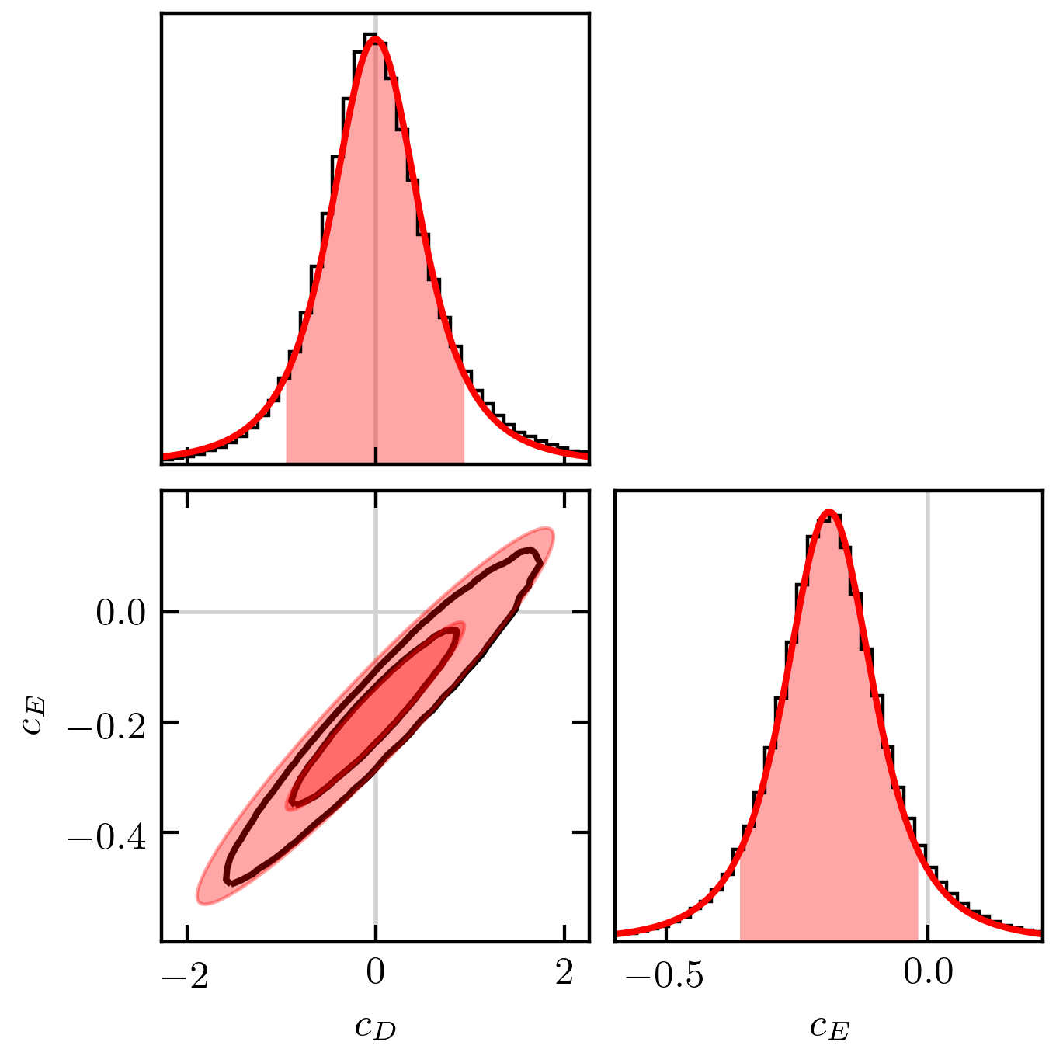
Posteriors from “Fast & Rigorous” [PRC 104, 064001 (2021)]
Posterior for c_{D} and c_{E}
Correlation of ρ ≈ 0.96 for this χEFT Hamiltonian
Tails are not well approximated by a Gaussian! (But do look like t’s!)
Sample pdf with MCMC over 11 NN LECs + c_{D}, c_{E} + Q, c² → marginalize (integrate out) what you are not considering
Notes:
Two mistakes in using results in first graph by the peak and sd treated as Gaussian: you miss the correlation and you miss the tails – not a Gaussian but essentially a Student t distribution.
Emphasize that these are specific results, but it is a *framework* available to all through Jupyter notebooks.
For PPD, statistically consistent *only* if the truncation error is included.
&{\color{black}\pr(\mathbf{y}|\mathbf{x},\mathbf{y}_{\rm exp})} = \\ & \quad\int\! \pr(\mathbf{y}|\mathbf{x},\bm{\theta}) p(\bm{\theta}|\mathbf{y}_{\rm exp}) d\bm{\theta}
The distribution for Q peaks at about 1/3 with a 20% uncertainty.
This is consistent with χEFT considerations for few-body observables [(m_{π})^{eff}/Λ_{b}] and with other estimations (cf. LENPIC papers).
This is what the data prefer for the size of the N³LO uncertainty.
Propagate errors from pdf for LECs learned from data to the observables.
Analysis is statistically consistent (experimental data are black circles) as long as truncation errors included.
Some observables are highly correlated; some are not.

Slide 32
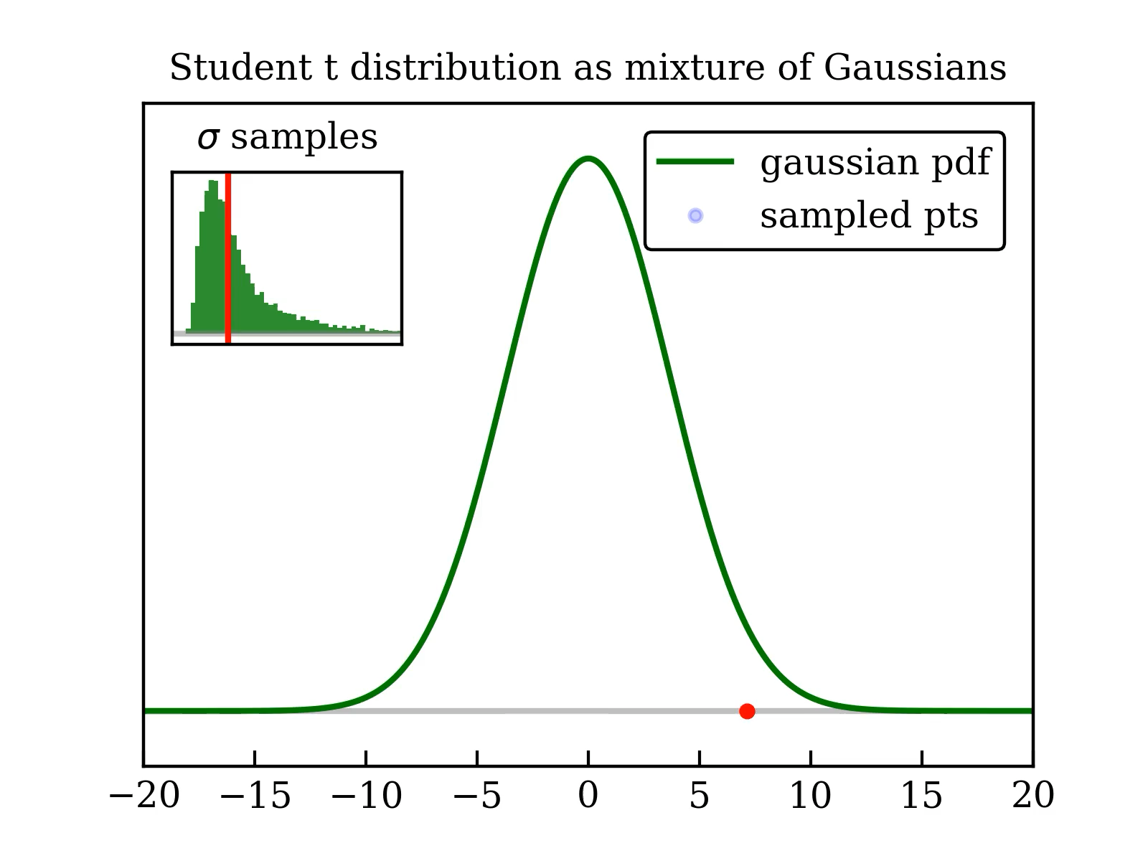
How do student t distributions arise?
Link to blog page
Link to D. Bailey
Posterior for c_{D} and c_{E}
Correlation of ρ ≈ 0.96 for this χEFT Hamiltonian
Tails are not well approximated by a Gaussian! (But do look like t’s!)
See appendix A of arXiv:2104.04441
Sample pdf with MCMC over 11 NN LECs + c_{D}, c_{E} + Q, c² → marginalize (integrate out) what you are not considering
Notes:
https://stats.stackexchange.com/questions/52906/student-t-as-mixture-of-gaussian/59520#59520

Slide 33
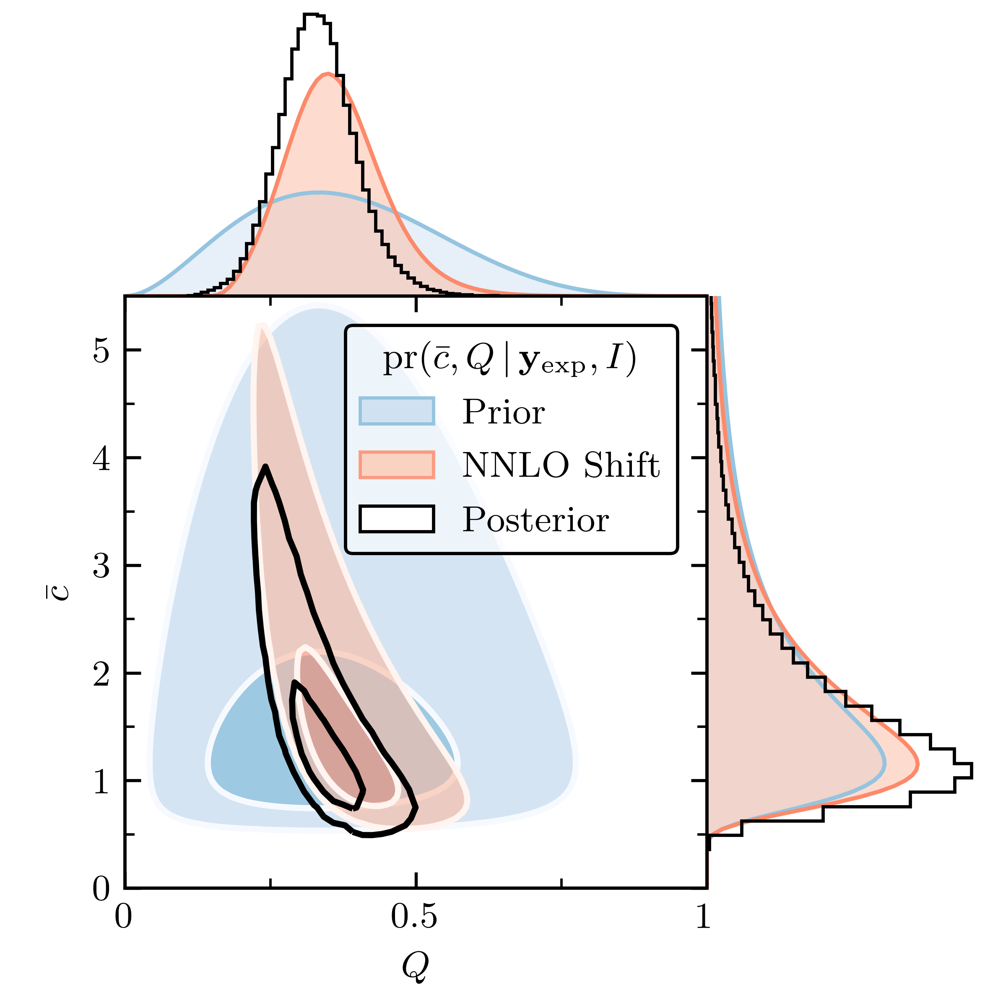
Posteriors from “Fast & Rigorous” [PRC 104, 064001 (2021)]
Posterior for c_{D} and c_{E}
Posterior for Q and c
Correlation of ρ ≈ 0.96 for this χEFT Hamiltonian
Tails are not well approximated by a Gaussian! (But do look like t’s!)
Truncation error for observables:
Sample pdf with MCMC over 11 NN LECs + c_{D}, c_{E} + Q, c² → marginalize (integrate out) what you are not considering
Notes:
Two mistakes in using results in first graph by the peak and sd treated as Gaussian: you miss the correlation and you miss the tails – not a Gaussian but essentially a Student t distribution.
Emphasize that these are specific results, but it is a *framework* available to all through Jupyter notebooks.
For PPD, statistically consistent *only* if the truncation error is included.
&{\color{black}\pr(\mathbf{y}|\mathbf{x},\mathbf{y}_{\rm exp})} = \\ & \quad\int\! \pr(\mathbf{y}|\mathbf{x},\bm{\theta}) p(\bm{\theta}|\mathbf{y}_{\rm exp}) d\bm{\theta}
The distribution for Q peaks at about 1/3 with a 20% uncertainty.
This is consistent with χEFT considerations for few-body observables [(m_{π})^{eff}/Λ_{b}] and with other estimations (cf. LENPIC papers).
This is what the data prefer for the size of the N³LO uncertainty.
Propagate errors from pdf for LECs learned from data to the observables.
Analysis is statistically consistent (experimental data are black circles) as long as truncation errors included.
Some observables are highly correlated; some are not.

Slide 34
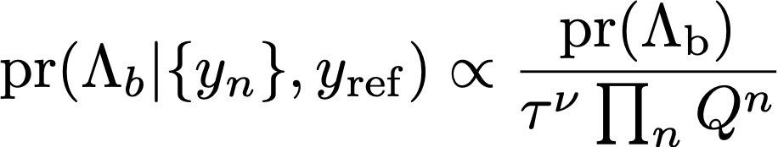
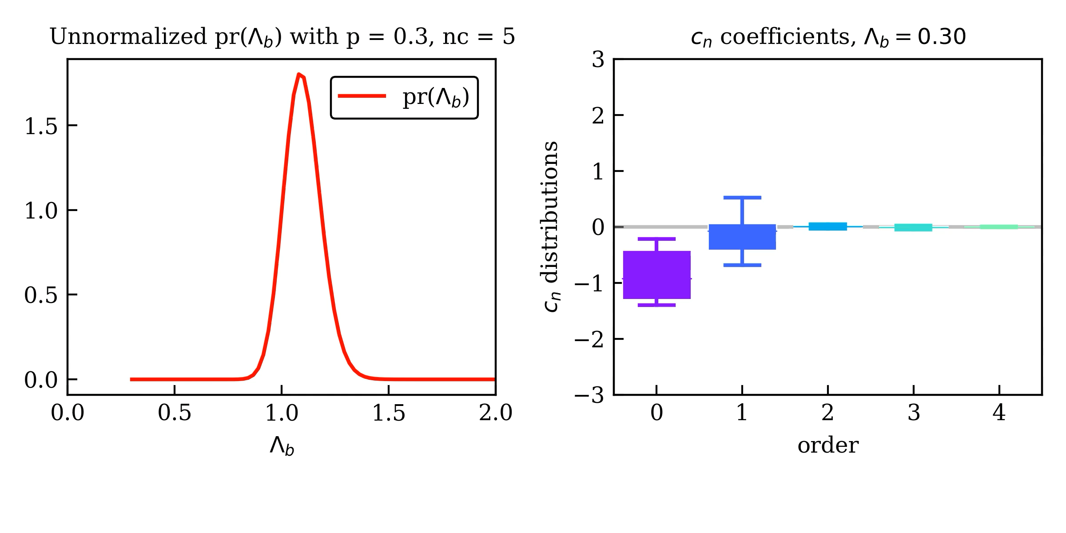
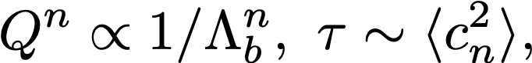
Limits of EFTs: Learning the expansion parameter
Model:
Melendez et al. (2019):
Expectation:
With the posterior favors Λ_{b} with same c_{n} variance for all n
Notes:
Consistent with mpi^{eff}/\Lambda_b
Other ways to determine limits? RG? Lepage plots (residuals with experiment as opposed to internal)
{\rm pr}(\Lambda_b | \{y_n\}, y_{\rm ref}) \propto \frac{\rm pr(\Lambda_b)}{\tau^{\nu}\prod_n Q^n}

Slide 35
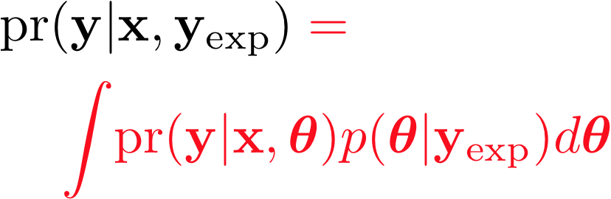
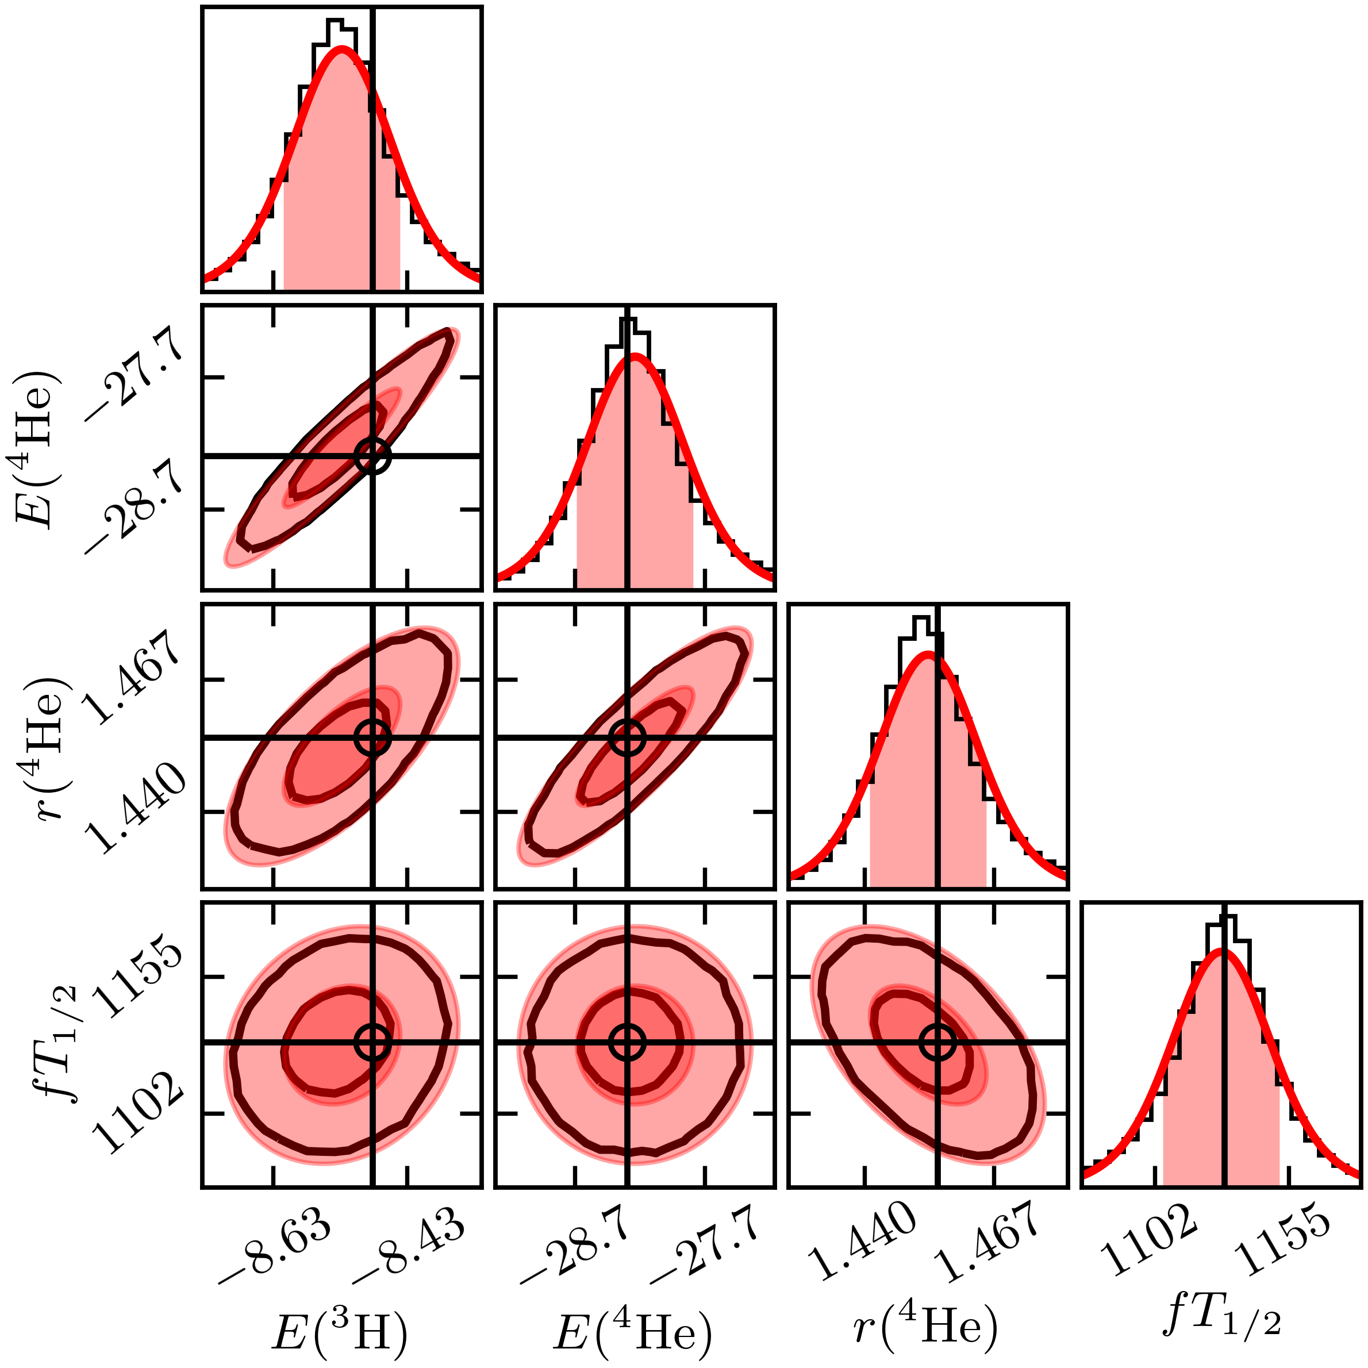
Posteriors from “Fast & Rigorous” [PRC 104, 064001 (2021)]
Propagate uncertainties through the calculation
Posterior for c_{D} and c_{E}
Posterior for Q and c
Posterior predictive distribution
Correlation of ρ ≈ 0.96 for this χEFT Hamiltonian
Statistically consistent!
Tails are not well approximated by a Gaussian! (But do look like t’s!)
Truncation error for observables:
Sample pdf with MCMC over 11 NN LECs + c_{D}, c_{E} + Q, c² → marginalize (integrate out) what you are not considering
Notes:
Two mistakes in using results in first graph by the peak and sd treated as Gaussian: you miss the correlation and you miss the tails – not a Gaussian but essentially a Student t distribution.
Emphasize that these are specific results, but it is a *framework* available to all through Jupyter notebooks.
For PPD, statistically consistent *only* if the truncation error is included.
&{\color{black}\pr(\mathbf{y}|\mathbf{x},\mathbf{y}_{\rm exp})} = \\ & \quad\int\! \pr(\mathbf{y}|\mathbf{x},\bm{\theta}) p(\bm{\theta}|\mathbf{y}_{\rm exp}) d\bm{\theta}
The distribution for Q peaks at about 1/3 with a 20% uncertainty.
This is consistent with χEFT considerations for few-body observables [(m_{π})^{eff}/Λ_{b}] and with other estimations (cf. LENPIC papers).
This is what the data prefer for the size of the N³LO uncertainty.
Propagate errors from pdf for LECs learned from data to the observables.
Analysis is statistically consistent (experimental data are black circles) as long as truncation errors included.
Some observables are highly correlated; some are not.

Slide 36
Posteriors from “Fast & Rigorous” [PRC 104, 064001 (2021)]
Propagate uncertainties through the calculation
Posterior for c_{D} and c_{E}
Posterior for Q and c
Posterior predictive distribution
Correlation of ρ ≈ 0.96 for this χEFT Hamiltonian
Statistically consistent!
Tails are not well approximated by a Gaussian! (But do look like t’s!)
Truncation error for observables:
Sample pdf with MCMC over 11 NN LECs + c_{D}, c_{E} + Q, c² → marginalize (integrate out) what you are not considering
Notes:
Two mistakes in using results in first graph by the peak and sd treated as Gaussian: you miss the correlation and you miss the tails – not a Gaussian but essentially a Student t distribution.
Emphasize that these are specific results, but it is a *framework* available to all through Jupyter notebooks.
For PPD, statistically consistent *only* if the truncation error is included.
&{\color{black}\pr(\mathbf{y}|\mathbf{x},\mathbf{y}_{\rm exp})} = \\ & \quad\int\! \pr(\mathbf{y}|\mathbf{x},\bm{\theta}) p(\bm{\theta}|\mathbf{y}_{\rm exp}) d\bm{\theta}
The distribution for Q peaks at about 1/3 with a 20% uncertainty.
This is consistent with χEFT considerations for few-body observables [(m_{π})^{eff}/Λ_{b}] and with other estimations (cf. LENPIC papers).
This is what the data prefer for the size of the N³LO uncertainty.
Propagate errors from pdf for LECs learned from data to the observables.
Analysis is statistically consistent (experimental data are black circles) as long as truncation errors included.
Some observables are highly correlated; some are not.

Slide 37
BAND (Bayesian Analysis of Nuclear Dynamics)
Multiple models predict an observable: how to combine for the best prediction?
An NSF CSSI Framework (started 7/2020)
Look to https://bandframework.github.io/ for papers, talks, and software!
Notes:
Cyberinfrastructure for Sustained Scientific Innovation

Slide 38
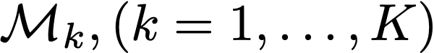
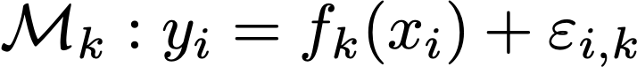
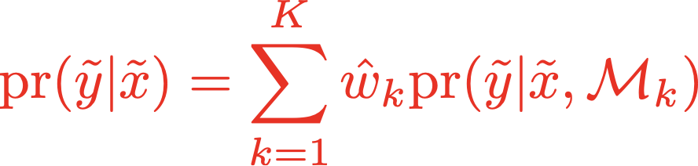
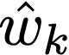
Bayesian model mixing → BMA
General: K models
Specify a model by predictions for observations y_{i} at points x_{i} →
Predictions at new input points:
Bayesian Model Averaging (BMA) has constant weights , determined by predictive power.
Improves predictive performance in weather forecasting [Raftery et al., (2005)]
BMA predictive PDF for temperature forecast
Observation
BMA
Models
Temperature
Notes:
Compare weighting for BMA by evidence vs. model mixing strategies (stacking, BART, others)
\mathcal{M}_k, (k=1,\ldots, K)
\mathcal{M}_k : y_i = f_k(x_i) + \varepsilon_{i,k}
{\rm pr}(\tilde y | \tilde x) = \sum_{k=1}^{K} \hat w_k {\rm pr}(\tilde y | \tilde x, \mathcal{M} _k)
F(g) = \int_{-\infty}^{\infty} dx~ e^{-\frac{x^{2}}{2} - g^{2} x^{4}}

Slide 39
Limits of the nuclear landscape: Bayesian model averaging (BMA)
Uses 11 global nuclear mass models
Total: 7708 ± 534 nuclei
L. Neufcourt et al., Phys. Rev. C 101, 014319 (2020); arXiv:2001.05924
Probability for each nucleus (Z,N) to be bound shown as a color. Dripline at 50%.

Slide 40
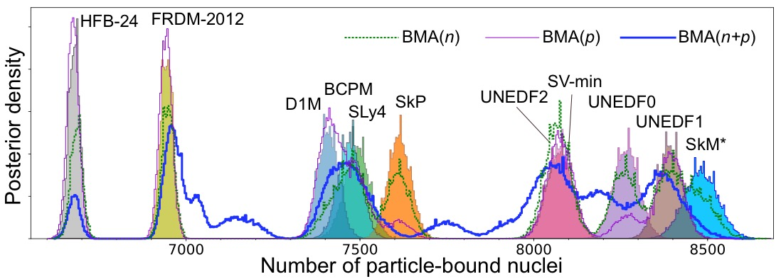
Limits of the nuclear landscape: Bayesian model averaging (BMA)
Rather than equal weights, average the models according to their predictive abilities: BMA
Uses 11 global nuclear mass models
Total: 7708 ± 534 nuclei
L. Neufcourt et al., Phys. Rev. C 101, 014319 (2020); arXiv:2001.05924
Probability for each nucleus (Z,N) to be bound shown as a color. Dripline at 50%.

Slide 41
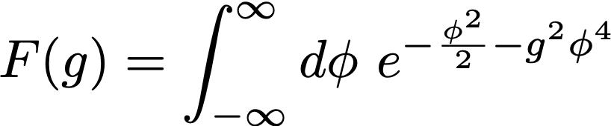
Toy Bayesian model mixing (BMM) example
General: K models
Specify a model by predictions for observations y_{i} at points x_{i} →
Predictions at new input points:
Bayesian Model Averaging (BMA) has constant weights ; for BMM they depend on x_{i}.
Semposki et al., PRC (2022);
Test strategies with expansions of:
and truncation error models.
A. Semposki
J. Yanotty
Notes:
Compare weighting for BMA by evidence vs. model mixing strategies (stacking, BART, others)
\mathcal{M}_k, (k=1,\ldots, K)
\mathcal{M}_k : y_i = f_k(x_i) + \varepsilon_{i,k}
{\rm pr}(\tilde y | \tilde x) = \sum_{k=1}^{K} \hat w_k {\rm pr}(\tilde y | \tilde x, \mathcal{M} _k)
F(g) = \int_{-\infty}^{\infty} dx~ e^{-\frac{x^{2}}{2} - g^{2} x^{4}}

Slide 42
BAND (Bayesian Analysis of Nuclear Dynamics)
Experimental design requires uncertainties from both experiment and models
An NSF CSSI Framework (started 7/2020)
Look to https://bandframework.github.io/ for papers, talks, and software!
Notes:
Cyberinfrastructure for Sustained Scientific Innovation

Slide 43
Goal: maximize benefits – minimize cost (time, money, workforce)
Example: Design of future 𝛾p Compton scattering experiments
What experimental (ω, 𝜃) are most useful for constraining polarizabilities and testing theory?
Given: (1) Present polarizability error bars; (2) experimental constraints; (3) χEFT accuracy decreases as ω↑.
Nucleon polarizabilities from Compton scattering with 𝝌EFT
Griesshammer, McGovern, Phillips, EPJA (2018)
Experiments: HI𝛾S; A2@MAMI → tension with 𝝌EFT valid range
What does a Bayesian analysis of experimental design look like?
[J. Melendez et al, Eur. Phys. J. A 57, 3 (2021)]
Notes:
The expected utility eq. (23) of proton differential cross section (dσ) measurements. Colors indicate the utility of one measurement conducted at each kinematic point (ωlab, θlab), with the point of largest utility UKL being by definition the optimal 1-point design. (The color bar is on a linear scale, though the hue varies much more quickly for small UKL.) The top row (with the red, “No δyth” box) does not include EFT truncation estimates, whereas the bottom row does include the EFT uncertainty. Each column shows the utility one could expect to achieve for a subset of the proton polarizabilities: the first column considers all polarizabilities together, while the second and third show the gain for αE1 ± βM 1 individually, and the final column reflects the collective information to be learned about the four spin polarizabilities {γi}. The interior box that excludes ω < 60 MeV along with forward and backward angles marks the experimentally accessible regime (see text for further discussion). The vertical line marks the cusp at the pion-production threshold. To visualize the full range of variation in the subplots, the color ranges from zero to a saturation point calculated by averaging the optimal utilities across all subplots. Contour lines are added for utilities above the saturation point, with the first contour at saturation and subsequent contour lines at intervals of 50% of the color range, see the top left subplot. To help visualize the utilities from less-constraining measurements, additional contours are added to any subplot whose maximum utility is less than 10% of the color range, see, e.g., fig. 6. Unless otherwise stated, the color ranges are common to all subplots within a figure, but different between figures. The white circles with black borders show the optimal five-point design kinematics, as described in the text. The effect of including EFT truncation errors is striking: it shifts the region of optimal utility to lower energies and moderates the expected utility.
\documentclass[10pt]{article}
\usepackage[usenames]{color} %used for font color
\usepackage{amssymb} %maths
\usepackage{amsmath} %maths
\usepackage[utf8]{inputenc} %useful to type directly diacritic characters
\newcommand{\design}{{\color{blue}\mathbf{d}}}
\DeclareMathOperator*{\argmax}{arg\,max}
\newcommand{\shrinkage}{\mathcal{S}}
\newcommand{\omegalab}{\omega_{\text{lab}}}
\newcommand{\given}{\,|\,} % Use for | in \pr
%\DeclareMathOperator{\pr}{pr} % Good, but want to handle sizing and | spacing?
\DeclareMathOperator{\pr}{p} % Good, but want to handle sizing and | spacing?
% Now add spacing:
% Derivatives
\newcommand{\dd}{d}
\newcommand{\diffcs}{d\sigma} % differential cross section
\newcommand{\genobs}{y}
\newcommand{\genobsset}{{\color{green}\inputvec{\genobs}}}
\newcommand{\inputvec}{\mathbf}
\newcommand{\lecs}{{\color{red}\vec{a}}}
\mbox{Utility of {\color{blue}design}: }& \mbox{information gain averaged over {\color{red}parameters} and {\color{green}measurements}}
\\
U_{\text{KL}}(\design)
& = \int \!\!\left\{ \ln\!\!\left[\frac{\pr(\lecs \given \genobsset, \design)}{\pr(\lecs)}\right]\! \pr(\lecs \given \genobsset, \design) \dd{\lecs}\right\}\!
\pr(\genobsset \given \design) \dd{\genobsset} \quad\mbox{(cf.\ entropy)} \\
& \longrightarrow \frac{1}{2} \ln \frac{|V_0|}{|V(\design)|} \equiv \ln\shrinkage(\design) \quad\mbox{``Posterior shrinkage''}

Slide 44
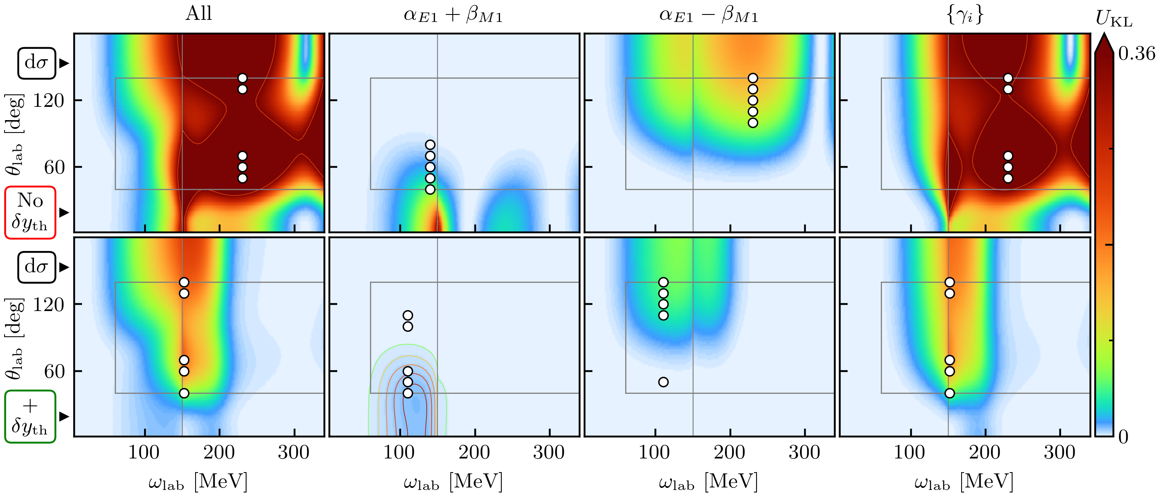

Example: Design of future 𝛾p Compton scattering experiments
What experimental (ω, 𝜃) are most useful for constraining polarizabilities and testing theory?
Given: (1) Present polarizability error bars; (2) experimental constraints; (3) χEFT accuracy decreases as ω↑.
J. Melendez et al. (2021)
Notes:
How much does the posterior shrink the prior region?
The expected utility eq. (23) of proton differential cross section (dσ) measurements. Colors indicate the utility of one measurement conducted at each kinematic point (ωlab, θlab), with the point of largest utility UKL being by definition the optimal 1-point design. (The color bar is on a linear scale, though the hue varies much more quickly for small UKL.) The top row (with the red, “No δyth” box) does not include EFT truncation estimates, whereas the bottom row does include the EFT uncertainty. Each column shows the utility one could expect to achieve for a subset of the proton polarizabilities: the first column considers all polarizabilities together, while the second and third show the gain for αE1 ± βM 1 individually, and the final column reflects the collective information to be learned about the four spin polarizabilities {γi}. The interior box that excludes ω < 60 MeV along with forward and backward angles marks the experimentally accessible regime (see text for further discussion). The vertical line marks the cusp at the pion-production threshold. To visualize the full range of variation in the subplots, the color ranges from zero to a saturation point calculated by averaging the optimal utilities across all subplots. Contour lines are added for utilities above the saturation point, with the first contour at saturation and subsequent contour lines at intervals of 50% of the color range, see the top left subplot. To help visualize the utilities from less-constraining measurements, additional contours are added to any subplot whose maximum utility is less than 10% of the color range, see, e.g., fig. 6. Unless otherwise stated, the color ranges are common to all subplots within a figure, but different between figures. The white circles with black borders show the optimal five-point design kinematics, as described in the text. The effect of including EFT truncation errors is striking: it shifts the region of optimal utility to lower energies and moderates the expected utility.
\documentclass[10pt]{article}
\usepackage[usenames]{color} %used for font color
\usepackage[dvipsnames]{xcolor}
\usepackage{amssymb} %maths
\usepackage{amsmath} %maths
\usepackage[utf8]{inputenc} %useful to type directly diacritic characters
\newcommand{\design}{{\color{blue}\mathbf{d}}}
\DeclareMathOperator*{\argmax}{arg\,max}
\newcommand{\shrinkage}{\mathcal{S}}
\newcommand{\omegalab}{\omega_{\text{lab}}}
\newcommand{\given}{\,|\,} % Use for | in \pr
\DeclareMathOperator{\pr}{pr} % Good, but want to handle sizing and | spacing?
%\DeclareMathOperator{\pr}{p} % Good, but want to handle sizing and | spacing?
% Now add spacing:
% Derivatives
\newcommand{\dd}{d}
\newcommand{\diffcs}{d\sigma} % differential cross section
\newcommand{\genobs}{y}
\newcommand{\genobsset}{{\color{ForestGreen}\inputvec{\genobs}}}
\newcommand{\inputvec}{\mathbf}
\newcommand{\lecs}{{\color{red}\vec{a}}}
\mbox{Utility of \textbf{{\color{blue}design}}: }& \mbox{information gain averaged over \textbf{{\color{red}parameters}} and \textbf{{\color{ForestGreen}measurements}}}
\\
U_{\text{KL}}(\design)
& = \int \!\!\left\{ \ln\!\!\left[\frac{\pr(\lecs \given \genobsset, \design)}{\pr(\lecs)}\right]\! \pr(\lecs \given \genobsset, \design) \dd{\lecs}\right\}\!
\pr(\genobsset \given \design) \dd{\genobsset} \quad\mbox{(cf.\ entropy)}
% & \longrightarrow \frac{1}{2} \ln \frac{|V_0|}{|V(\design)|} \equiv \ln\shrinkage(\design) \quad\mbox{``Posterior shrinkage''}

Slide 45
Example: Design of future 𝛾p Compton scattering experiments
What experimental (ω, 𝜃) are most useful for constraining polarizabilities and testing theory?
Given: (1) Present polarizability error bars; (2) experimental constraints; (3) χEFT accuracy decreases as ω↑.
J. Melendez et al. (2021)
Without 𝛿y_{th}
With 𝛿y_{th}
Compare utility without to with model discrepancy 𝛿y_{th} ⇒ very different implications!
Notes:
The expected utility eq. (23) of proton differential cross section (dσ) measurements. Colors indicate the utility of one measurement conducted at each kinematic point (ωlab, θlab), with the point of largest utility UKL being by definition the optimal 1-point design. (The color bar is on a linear scale, though the hue varies much more quickly for small UKL.) The top row (with the red, “No δyth” box) does not include EFT truncation estimates, whereas the bottom row does include the EFT uncertainty. Each column shows the utility one could expect to achieve for a subset of the proton polarizabilities: the first column considers all polarizabilities together, while the second and third show the gain for αE1 ± βM 1 individually, and the final column reflects the collective information to be learned about the four spin polarizabilities {γi}. The interior box that excludes ω < 60 MeV along with forward and backward angles marks the experimentally accessible regime (see text for further discussion). The vertical line marks the cusp at the pion-production threshold. To visualize the full range of variation in the subplots, the color ranges from zero to a saturation point calculated by averaging the optimal utilities across all subplots. Contour lines are added for utilities above the saturation point, with the first contour at saturation and subsequent contour lines at intervals of 50% of the color range, see the top left subplot. To help visualize the utilities from less-constraining measurements, additional contours are added to any subplot whose maximum utility is less than 10% of the color range, see, e.g., fig. 6. Unless otherwise stated, the color ranges are common to all subplots within a figure, but different between figures. The white circles with black borders show the optimal five-point design kinematics, as described in the text. The effect of including EFT truncation errors is striking: it shifts the region of optimal utility to lower energies and moderates the expected utility.
\documentclass[10pt]{article}
\usepackage[usenames]{color} %used for font color
\usepackage{amssymb} %maths
\usepackage{amsmath} %maths
\usepackage[utf8]{inputenc} %useful to type directly diacritic characters
\newcommand{\design}{{\color{blue}\mathbf{d}}}
\DeclareMathOperator*{\argmax}{arg\,max}
\newcommand{\shrinkage}{\mathcal{S}}
\newcommand{\omegalab}{\omega_{\text{lab}}}
\newcommand{\given}{\,|\,} % Use for | in \pr
%\DeclareMathOperator{\pr}{pr} % Good, but want to handle sizing and | spacing?
\DeclareMathOperator{\pr}{p} % Good, but want to handle sizing and | spacing?
% Now add spacing:
% Derivatives
\newcommand{\dd}{d}
\newcommand{\diffcs}{d\sigma} % differential cross section
\newcommand{\genobs}{y}
\newcommand{\genobsset}{{\color{green}\inputvec{\genobs}}}
\newcommand{\inputvec}{\mathbf}
\newcommand{\lecs}{{\color{red}\vec{a}}}
\mbox{Utility of {\color{blue}design}: }& \mbox{information gain averaged over {\color{red}parameters} and {\color{green}measurements}}
\\
U_{\text{KL}}(\design)
& = \int \!\!\left\{ \ln\!\!\left[\frac{\pr(\lecs \given \genobsset, \design)}{\pr(\lecs)}\right]\! \pr(\lecs \given \genobsset, \design) \dd{\lecs}\right\}\!
\pr(\genobsset \given \design) \dd{\genobsset} \quad\mbox{(cf.\ entropy)} \\
& \longrightarrow \frac{1}{2} \ln \frac{|V_0|}{|V(\design)|} \equiv \ln\shrinkage(\design) \quad\mbox{``Posterior shrinkage''}

Slide 46
Outline
Thinking about uncertainty quantification (UQ) for models
BAND: emulators, calibration, model mixing, expt. design
Summary and outlook

Slide 47
Outlook: Frontiers of UQ for nuclear models
Checklist for statistically sound Bayesian inference
✓
Interact with the experts (i.e., statisticians, applied mathematicians)
Incorporate all sources of experimental and theoretical errors
Formulate statistical models for uncertainties
Use as informative priors as is reasonable; test sensitivity to priors
Account for correlations in inputs (type x) and observables (type y)
Propagate uncertainties through the calculation
Use model checking to validate our models
✓
✓
✓
✓
✓
✓
Notes:
sampling/importance resampling Christian Forssen Front.in Phys. 10 (2022) 1058809

Slide 48
Outlook: Frontiers of UQ for nuclear models
Emulators: new applications to 3N scattering, infinite matter, pairing, …; new technologies explored (e.g., MOR, active learning, AI/machine learning); new workflows enabled (bypass specialized knowledge).
Calibration: full Bayesian parameter estimation and uncertainty propagation.
Model mixing: BAND and other projects on nuclear EOS, EDFs, EFTs, …
Experimental design: exploring alternative approaches; sampling is feasible with emulators!
Software: e.g., BAND github repository → surmise, Taweret, ROSE, …
Physics discovery through statistics: e.g., exploit statistical correlations using Bayesian tools (spectra, 0𝜈𝛽𝛽, …); uncover power counting of EFT; …
Notes:
sampling/importance resampling Christian Forssen Front.in Phys. 10 (2022) 1058809

Slide 49
Slides:
Thank you!
https://go.osu.edu/msu2023
Coming attractions (sign up now!):
2023: ISNET-9 + BAND CAMP, May 22-26 , at Washington U. in St. Louis
2023: FRIB-TA Summer School on Practical Uncertainty Quantification and Emulator Development in Nuclear Physics, June 26-28, at FRIB.
Jupyter and Quora books:
Learning from Data (OSU course Physics 8820)
BUQEYE Guide to Projection-Based Emulators in Nuclear Physics
Reduced Basis Methods in Nuclear Physics
Notes:
2013-present: ISNET: Information and Statistics in Nuclear Experiment and Theory

Slide 50
Extra slides

Slide 51
Historical perspective: UQ for nuclear models
Pre-2010: If given, model uncertainties usually from conventional regression
2011: Physical Review A editorial calling for theory uncertainty estimates
2013: ISNET: Information and Statistics in Nuclear Experiment and Theory
2014: “Error Estimates of Theoretical Models: a Guide” [Dobaczewski et al]
2015: Journal of Physics G Special Focus Issue: ISNET
2016: Bayesian Methods in Nuclear Physics (ISNET-4) [INT, Seattle]
2020-1: J. Phys. G Special Focus Issue: ISNET 2.0
2022: Frontiers in Physics issue: Uncertainty Quantification in Nuclear Physics
2023: ISNET-9 + BAND CAMP, May 22-26 , at Washington U. in St. Louis
Notes:
Model uncertainties from standard regression or range of models

Slide 52

How do we sample efficiently?
Random walk (Metropolis-Hastings)
Used for most Bayesian sampling to date
For animations, see: McElreath blog entry on sampling and Chi Feng’s Markov-chain Monte Carlo Interactive Gallery

Slide 53


How do we sample efficiently?
Random walk (Metropolis-Hastings)
Hamiltonian Monte Carlo (HMC)
Used for most Bayesian sampling to date
Recent work by Chalmers group (arXiv:2206.08250) → HMC much more effective for many parameters!
For animations, see: McElreath blog entry on sampling and Chi Feng’s Markov-chain Monte Carlo Interactive Gallery

Slide 54
Light nuclei with semilocal momentum-space regularized chiral interactions up to [and beyond] N²LO
LENPIC Collaboration
P. Maris et al., PRC 103, 054001 (2021)
arXiv:2104.04441
P. Maris, R. Roth et al., PRC 106, 064002 (2022)
arXiv:2206.13303
https://www.lenpic.org/
Consistent NN and 3N potentials to N²LO [2022: NN to N⁴LO]
“Semilocal” to reduce regulator artifacts
c_{E} and c_{D} from ³H binding and Nd diff. cross section minimum
Calculations for few-body and p-shell+ nuclei (NCCI plus SRG)
Bayesian estimates of EFT truncation errors (also method error)
Many results (e.g., overbinding at N²LO and cutoff dependence reduced with higher-order NN; but radii still underpredicted).
c_{E}
c_{D}
Notes:
“Consistent” in multiple senses here: Evgeny will say more

Slide 55

Excitation energies are highly correlated
Theory minus experiment for selected excitation energies
Empirically: calculated excitation energies are better determined than each level.
Why? If E₁ and E₂ have δy_{th} variance σ², then E₂ – E₁ has 2σ² if uncorrelated but 2(1-ρ)σ² if correlated with ρ!
Plan: learn ρ from y_{th} coefficients c_{n}:
Bayesian 95% intervals for two cutoffs (blue & red)
Model checking: empirical coverage in agreement with experiment if correlations used for errors.
Diagnostic of physics: exceptions in ¹²C and ¹²B point to different theoretical correlations in the nuclear structure.
Higher order: >N²LO enables better estimates of correlations → more insight
Check if ≈95% of bars overlap zero
Coefficients for all the levels
Notes:
Use c3 to learn Q.
Use c2,c3 to learn rho.
Better estimates of correlations and Q.
Look for other opportunities to exploit correlations for physics in other nuclei!

Slide 56


Statistical diagnostics [Melendez et al. (2019) and Millican et al. (2023]
Mahalanobis distance (MD) squared
Chi-squared with correlations
Pivoted Cholesky (PC) decomposition
Indexed breakdown of MD linear algebra
Credible interval coverage
“Does 68% of the data fall within the 68% confidence intervals of the fitted GP?”
$Λ_{b},l_{C}$ joint posterior pdf
Uses Bayesian statistics to find conditional probabilities
Spin observable D (150 MeV) for SMS 450 MeV potential
Notes:
D (150 MeV) SMS 450 MeV
Qsum, Qofprel, cos

Slide 57

Statistical diagnostics [Melendez et al. (2019) and Millican et al. (2023]
Mahalanobis distance (MD) squared
Chi-squared with correlations
Pivoted Cholesky (PC) decomposition
Indexed breakdown of MD linear algebra
Credible interval coverage
“Does 68% of the data fall within the 68% confidence intervals of the fitted GP?”
$Λ_{b},l_{C}$ joint posterior pdf
Uses Bayesian statistics to find conditional probabilities
Spin observable D (150 MeV) for SCS 1.2 fm potential
Notes:
D (150 MeV) SMS 450 MeV
Qsum, Qofprel, cos

Slide 58

Role of emulators: new workflows for EFT applications
From Xilin Zhang, rjf, Fast emulation of quantum three-body scattering, Phys. Rev. C 105, 064004 (2022).
If you can create fast & accurate™ emulators for observables, you can do calculations without specialized knowledge and expensive resources!

Slide 59
Experimental design: A case study
Maximize benefits – minimize cost (time, money, workforce)
Nucleon polarizabilities from Compton scattering with ChiEFT
[Harald Griesshammer, Judith McGovern, Daniel Phillips, EPJA (2018)]
How do constituents of the nucleon react to external fields?
How to reliably extract proton, neutron, spin polarizabilities?
How to plan effective experiments and test theory?
Experiments: HI𝛾S; A2@MAMI → tension with ChiEFT valid range

Slide 60
Optimizing the design of future Compton scattering experiments
How to plan effective experiments & test theory? What (ω, 𝜃) are most useful for constraining?
Ingredient: Calculate a utility function for sum of variances for each kinematic point on a grid.
Apply to decide on trade-off between different allocations of experimental resources (exploration vs. exploitation).
1-point vs 5-point?
Increase precision or more points?
J. Melendez et al. (in prep.)

Slide 61












Correlated theory errors for EOS properties
C. Drischler et al.
at 0.17 ± 0.01 fm³
Correlated GP treatment gives better estimates for truncation errors and clean propagation of uncertainties to derived quantities.

Slide 62


Workflow

Slide 63

Limits of EFTs: Learning the expansion parameter
Melendez et al. (2019):
Model:
Expectation:
Λ_{b} from NN observables
Λ_{b} from infinite matter
With the posterior favors Λ_{b} with same c_{n} variance for all n
Millican et al., in prep [also Melendez et al., PRC (2017) and PRC (2019).]
SMS 450 MeV
Are different Λ_{b} posteriors consistent? Other ways?
How do correlations affect the estimation of the breakdown scale?
…
Drischler et al., PRC (2020)
Notes:
Consistent with mpi^{eff}/\Lambda_b
Other ways to determine limits? RG? Lepage plots (residuals with experiment as opposed to internal)
{\rm pr}(\Lambda_b | \{y_n\}, y_{\rm ref}) \propto \frac{\rm pr(\Lambda_b)}{\tau^{\nu}\prod_n Q^n}

Slide 64

Limits of EFTs: Learning the expansion parameter
Melendez et al. (2019):
Model:
Expectation:
Λ_{b} from NN observables
Λ_{b} from infinite matter
With the posterior favors Λ_{b} with same c_{n} variance for all n
Millican et al., in prep [also Melendez et al., PRC (2017) and PRC (2019).]
SMS 450 MeV
Are different Λ_{b} posteriors consistent? Other ways?
How do correlations affect the estimation of the breakdown scale?
…
Drischler et al., PRC (2020)
Notes:
Consistent with mpi^{eff}/\Lambda_b
Other ways to determine limits? RG? Lepage plots (residuals with experiment as opposed to internal)
{\rm pr}(\Lambda_b | \{y_n\}, y_{\rm ref}) \propto \frac{\rm pr(\Lambda_b)}{\tau^{\nu}\prod_n Q^n}

Slide 65

Limits of EFTs: Learning the expansion parameter
What about spectra of light nuclei? Convergence pattern obscured at low order by KE vs. PE cancellation. → only use higher orders → Q ≈ 0.3 [consistent with (m_{π})^{eff.}/Λ_{b} (see Ref.) ]
Model:
Expectation:
Q from few-body observables
Q from nuclear energies (A < 8 vs. A ≥ 8)
Wesolowski et al., PRC (2021)
Maris, Roth et al., PRC (2022)
Notes:
Consistent with mpi^{eff}/\Lambda_b

Slide 66
Account for correlations in inputs and observables
pr(x, y| z) “joint probability (density) of x and y given z” (contingent on z)
marginalized
pr(x|z)
pr(y|z)
joint
y
pr(x,y|z)
X
y
Notes:
\mathcal{N}e^{-\frac12 \mathbf{r}^{\intercal}{\color{red}\Sigma^{-1}}\mathbf{r}}
&= \mathcal{N} e^{-\frac{(x-\mu)^2}{2\sigma_x^2}} e^{-\frac{(y-\mu)^2}{2\sigma_y^2}}
\\
\mathbf{r} = \begin{bmatrix} x \\ y \end{bmatrix} &
\qquad
{\color{red}\Sigma = \begin{bmatrix} \sigma_x^2 & 0 \\
0 & \sigma_y^2
\end{bmatrix}}
\mathcal{N}e^{-\frac12 \mathbf{r}^{\intercal}{\color{red}\Sigma^{-1}}\mathbf{r}}
&= \mbox{correlated gaussian}
% = \mathcal{N} e^{-\frac{(x-\mu)^2}{2\sigma^2}} e^{-\frac{(y-\mu)^2}{2\sigma^2}}
\\
\mathbf{r} = \begin{bmatrix} x \\ y \end{bmatrix}
\qquad &
{\color{red}\Sigma = \begin{bmatrix} \sigma_x^2 & \rho\sigma_x\sigma_y \\
\rho\sigma_x\sigma_y & \sigma_y^2
\end{bmatrix}}

Slide 67
Bayes’s Theorem: How to update knowledge in PDFs
Bayesian updating of knowledge
Likelihood overwhelms prior
Prior suppresses unconstrained likelihood
cf. regularization in neural networks
Notes:
\usepackage{bm}
\DeclareMathOperator{\pr}{\text{pr}} % Good, but want to handle sizing and | spacing?
{\color{red}\pr(A|B,I)} = \frac{{\color{blue}\pr(B|A,I)} {\color[rgb]{0.000000,0.493151,0.000000}\pr(A|I)}}{\pr(B|A)}
\Longrightarrow
{\color{red}\underbrace{\pr(\bm{\theta} | \mathbf{y}_{\rm exp}, I)}_{\mbox{\scriptsize posterior}}}
\propto
{\color{blue}\underbrace{\pr(\mathbf{y}_{\rm exp} | \bm{\theta}, I)}_{\mbox{\scriptsize likelihood}}}
\times
{\color[rgb]{0.000000,0.493151,0.000000}\underbrace{\pr(\bm{\theta} | I)}_{\mbox{\scriptsize prior}}}
{\color{red}\pr(A|B,I)} = \frac{{\color{blue}\pr(B|A,I)} {\color[rgb]{0.000000,0.493151,0.000000}\pr(A|I)}}{\pr(B|A)}
\Longrightarrow
{\color{red}\underbrace{\pr(x | \mbox{data}, I)}_{\mbox{posterior}}}
\propto
{\color{blue}\underbrace{\pr(\mbox{data} | x, I)}_{\mbox{likelihood}}}
\times
{\color[rgb]{0.000000,0.493151,0.000000}\underbrace{\pr(\mbox{data} | I)}_{\mbox{prior}}}
{\color{red}\pr(\bm{\theta} | \mathrm{y}_{\rm exp}, \Sigma_{\rm exp}, \Sigma_{\rm th}, I)}
\propto {\color{blue}e^{-\frac12 \mathbf{r}^{\intercal}(\Sigma_{\rm exp}+\Sigma_{\rm th})^{-1}\mathbf{r}}}
\times {\color[rgb]{0.000000,0.493151,0.000000} e^{-\bm{\theta}^2/2\bar\theta} }
\usepackage{bm}
\newcommand{\pr}{\text{pr}}
&{\color{blue}
%\mbox{likelihood: }
\pr(\mathbf{y}_{\rm exp} | \bm{\theta}, I) \propto e^{-\chi^2/2}
}
\quad\underset{\rm uncorrelated}{\Longrightarrow}\quad
{\color{blue}
\chi^2 = \sum_i^{\rm data} \mathbf{r}_i\frac{1}{\sigma_i^2}\mathbf{r}_i \;,
\quad
\mathbf{r} \equiv \mathbf{y}_{\rm exp} - \mathbf{y}_{\rm th}(\bm{\theta})
} \\[10pt]
&\quad\mbox{correlated: }
{\color{red}\pr(\bm{\theta} | \mathrm{y}_{\rm exp}, \Sigma_{\rm exp}, \Sigma_{\rm th}, I)}
\propto {\color{blue}e^{-\frac12 \mathbf{r}^{\intercal}(\Sigma_{\rm exp}+\Sigma_{\rm th})^{-1}\mathbf{r}}} \times {\color[rgb]{0.000000,0.493151,0.000000} e^{-\bm{\theta}^2/2\bar\theta^2} }
&{\color{blue}
%\mbox{likelihood: }
\pr(\mathbf{y}_{\rm exp} | \bm{\theta}, I) \propto e^{-\chi^2/2}
}
\quad\underset{\rm uncorrelated}{\Longrightarrow}\quad
{\color{blue}
\chi^2 = \sum_i^{\rm data} \mathbf{r}_i\frac{1}{\sigma_i^2}\mathbf{r}_i \;,
\quad
\mathbf{r} \equiv \mathbf{y}_{\rm exp} - \mathbf{y}_{\rm th}(\bm{\theta})
} \\[10pt]
&\quad\mbox{correlated: }
{\color{red}\pr(\bm{\theta} | \mathrm{y}_{\rm exp}, \Sigma_{\rm exp}, \Sigma_{\rm th}, I)}
\propto {\color{blue}e^{-\frac12 \mathbf{r}^{\intercal}(\Sigma_{\rm exp}+\Sigma_{\rm th})^{-1}\mathbf{r}}} \times {\color[rgb]{0.000000,0.493151,0.000000} e^{-\bm{\theta}^2/2\bar\theta^2} }

